Slide 1


Wastewater Master Plan Update - City of Tracy
August 22nd, 2023

Slide 2
Agenda
Existing Wastewater System
Master Plan Work Plan
Hydraulic Model
Existing Capacity Evaluation
Planned Development and Projected Flows
Future System Evaluation
Wastewater Treatment Plant
Capital Improvement Plan

Slide 3
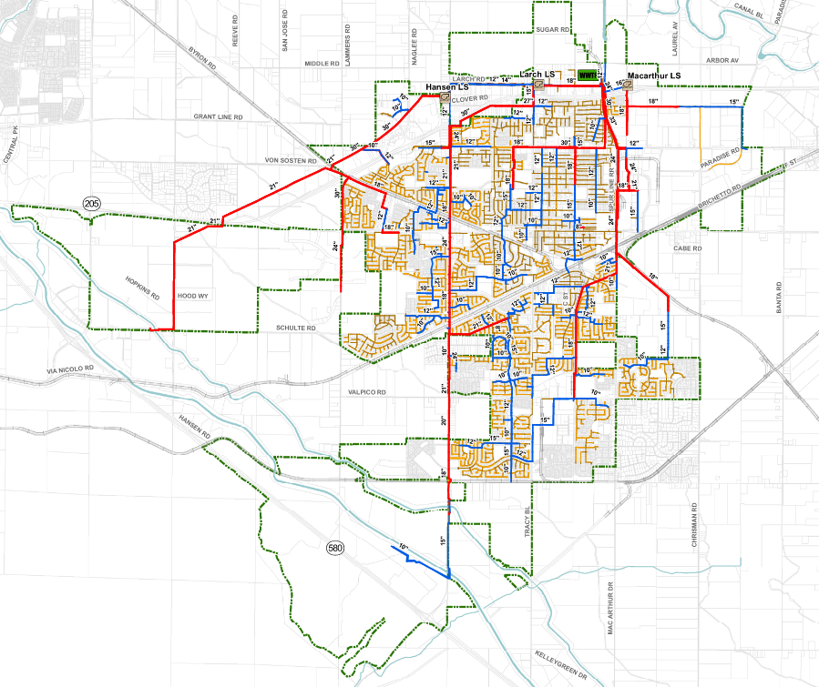
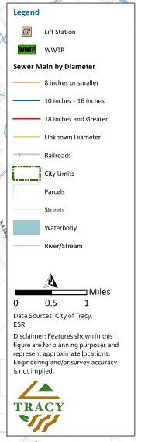
Existing Wastewater Collection System
210 miles of gravity sewer
4 to 48 inches in diameter
3 Wastewater Lift Stations
Serves Existing City Limits

Slide 4
Master Plan Evaluation Work Plan
Hydraulic Model Construction
Temporary Flow Monitoring
Existing and Future Flow Allocation
Establish Existing Conditions
Evaluate Planned Growth
Determine service plan
Develop Costs
Hydraulic Model Calibration
Evaluation/Capacity Analysis
Proposed Improvements
Capital Improvement Program

Slide 5
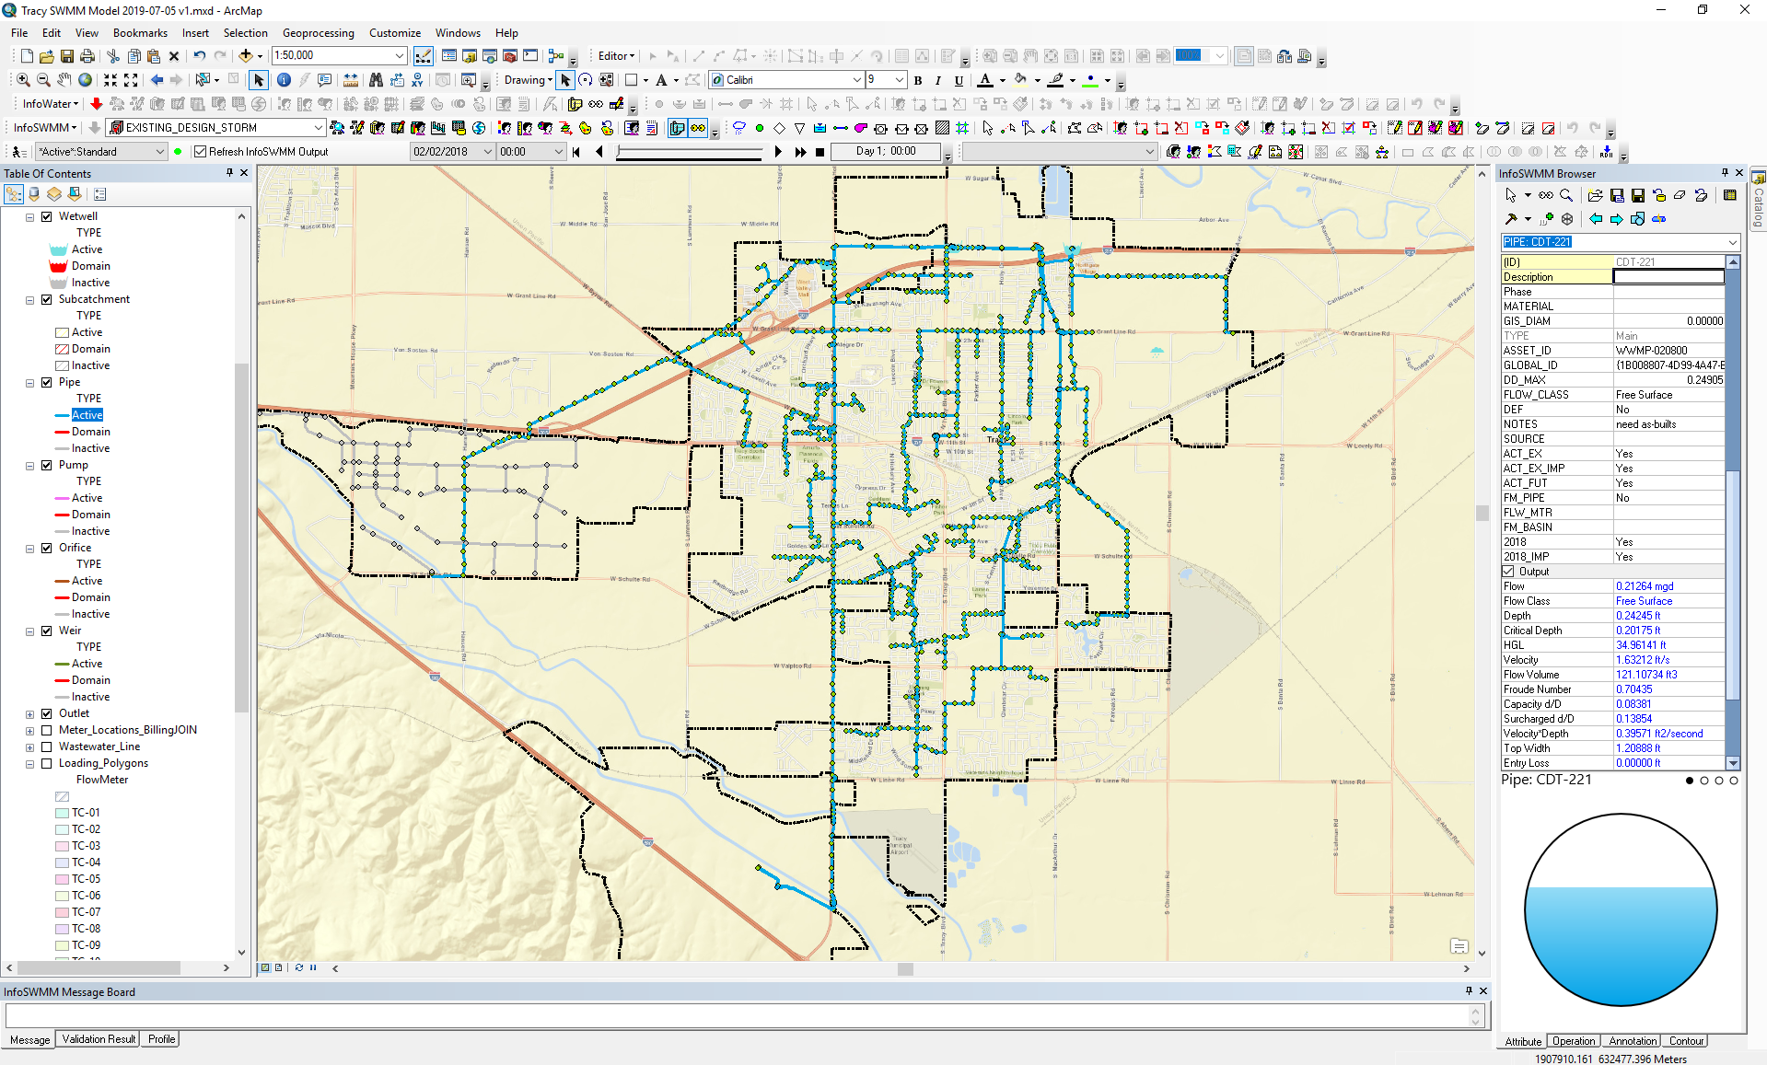
A hydraulic computer model was developed to evaluate capacity and ability to serve growth
Calibrated to Industry Standards
Temporary Flow Monitoring Program

Slide 6
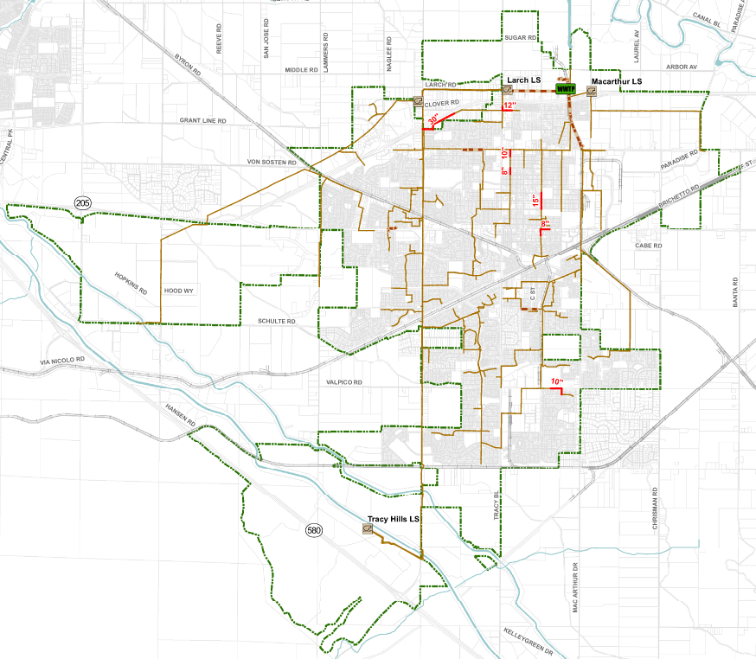
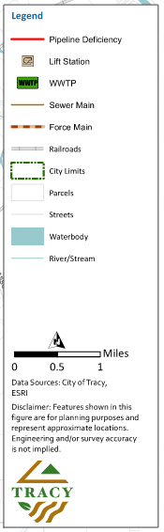
Evaluation of existing capacity showed good performance
Evaluation criteria was developed in coordination with City staff
Existing system is performing well in terms of hydraulic capacity
Deficiencies and improvements developed were evaluated based on risk

Slide 7
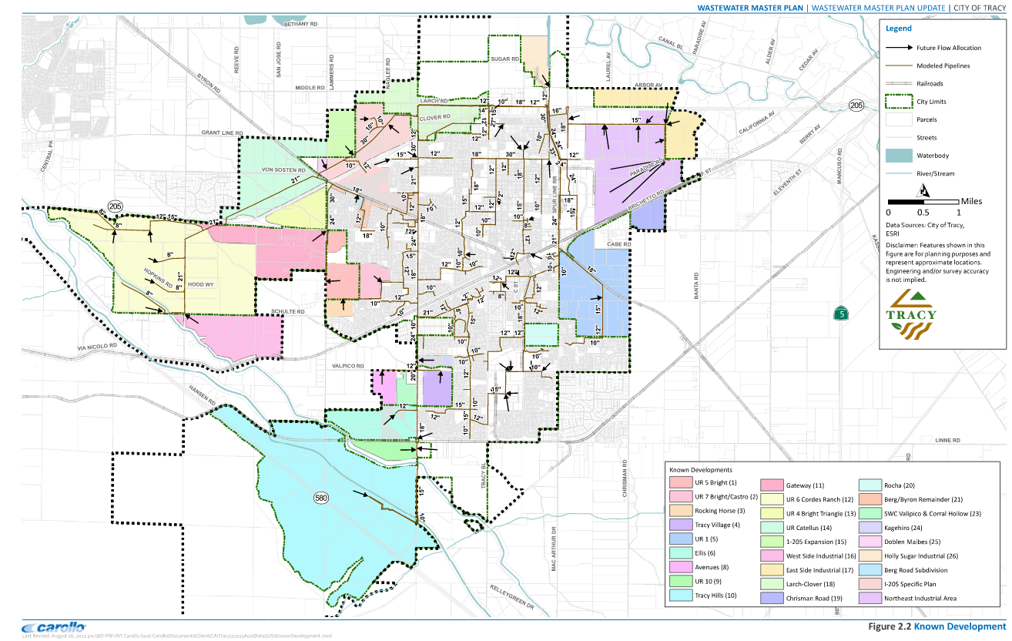
Evaluation of future developments established future conditions

Slide 8
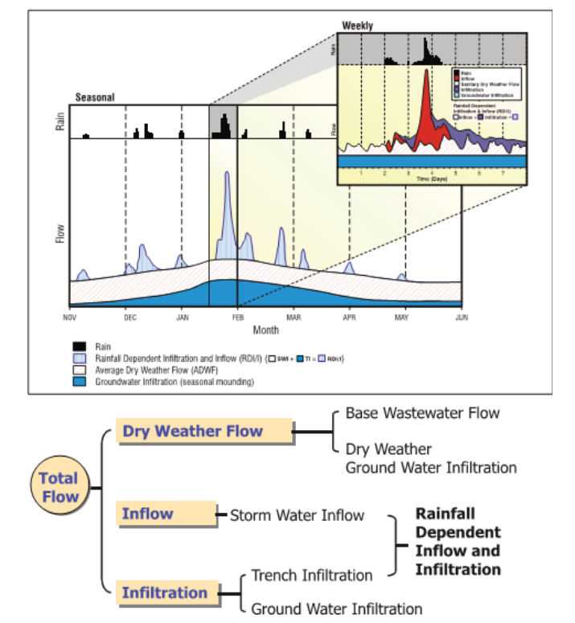
Wastewater flows include multiple components

Slide 9
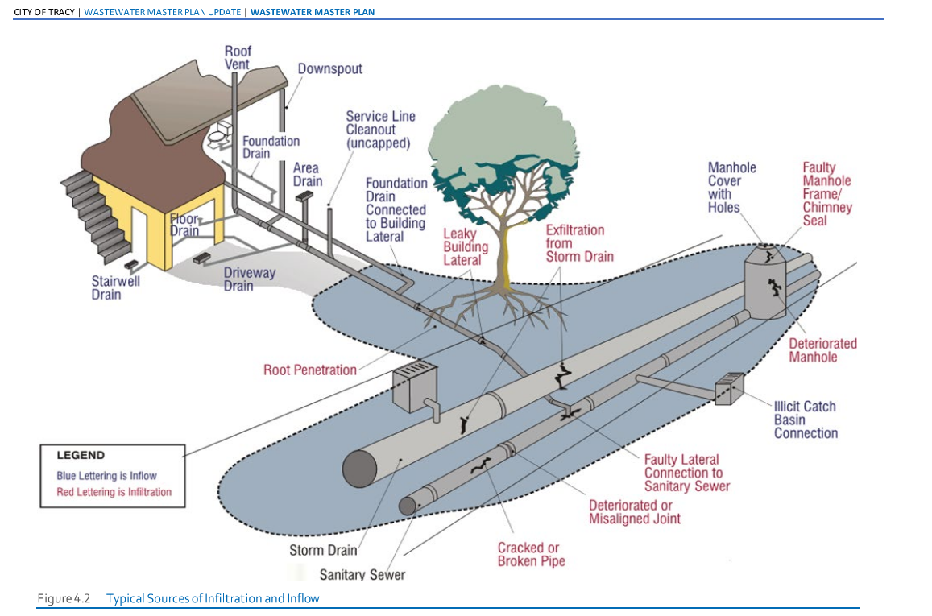
Typical sources of infiltration and inflows

Slide 10
Existing and future flows in million gallons per day (mgd)
Planning Horizon | Average Dry Weather Flow (ADWF, mgd) | Peak Wet Weather Flow (PWWF, mgd) | PWWF/ADWF Factor
Existing | 7.35 | 16.95 | 2.31
2040 | 12.22 | 25.35 | 2.07
Buildout | 15.65 | 30.14 | 1.93
PWWF = peak wet weather flow
ADWF = average dry weather flow
mgd = million gallons per day

Slide 11
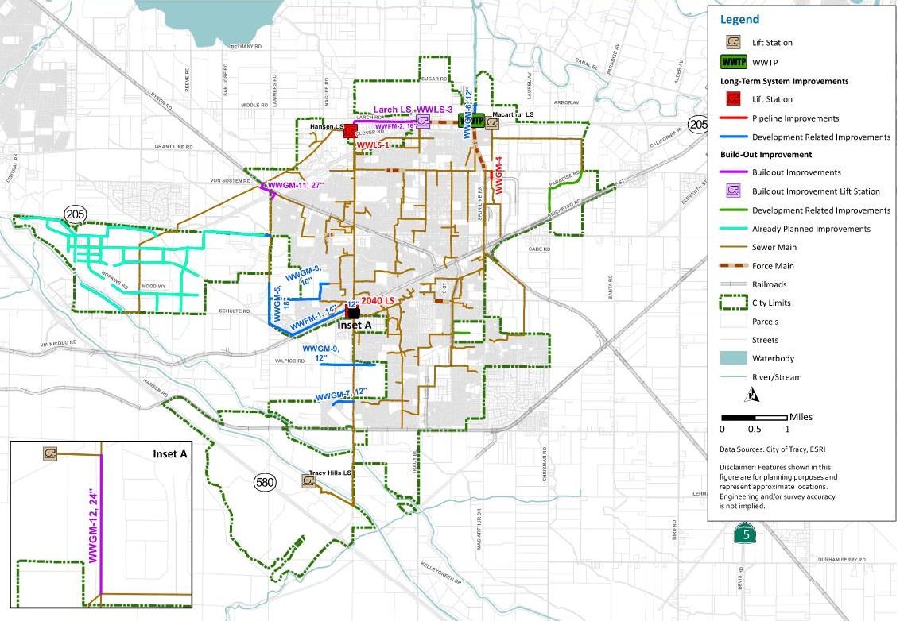
Future system evaluation

Slide 12
Wastewater Treatment Plant – Master Plan Phases
Phase 2
Revised Phase 3
Revised Phase 4
Phase 5
Phase 2A, 2B Completed
Phase 2C Designed
-Outfall and Aeriation Tanks Under Construction
Required for 2040 Flows
Required for Buildout Flows
Not required based on current projected flows

Slide 13
Wastewater Treatment Plant Expansion Phase 3
Revised Phase 3 Upgrades
Grit Removal Basin #3
Circular Clarifier #3
Primary Sludge Pump Station #2
Primary Effluent Equalization Tank #2
Aeration Basin #5
Secondary Clarifier #2
New WAS and Mixed Liquor Pump Station
Anaerobic Digester #4
Remove 1975 Trickling Filters
New Centrate Equalization Tank and Pump Station
New Sludge Drying Bed #4

Slide 14
Wastewater Treatment Plant Expansion Phase 4
Revised Phase 4 Upgrades
Additional Influent Screen and Channel
New Primary Effluent Equalization Pump Station
New Outfall Pipeline

Slide 15
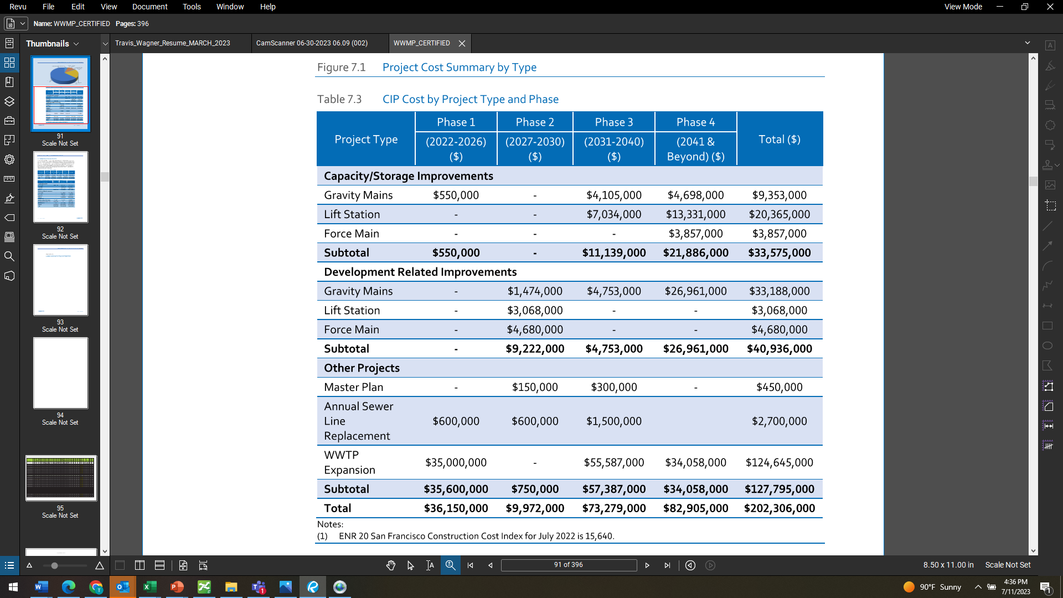
The capital improvement program included pipelines, pump stations, treatment, rehabilitation and replacement costs
Horizon 1
Horizon 2
Horizon 3
Horizon 4

Slide 16
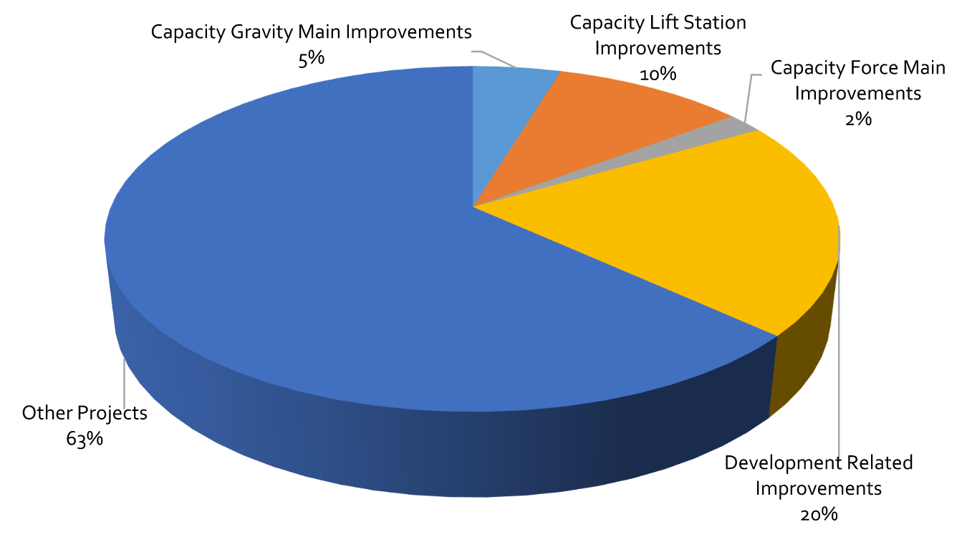
Capital costs by project type
“Other Projects” Include
  Treatment Plant Expansion
  Pipe replacement
  Future studies

Slide 17
The capital improvement plan costs were allocated to existing and future users
Reimbursement Category | Horizon 1 (2022-2026) (Million $) | Horizon 2 (2027-2030) (Million $) | Horizon 3 (2031-2040) (Million $) | Horizon 4 (2041- and beyond) (Million $) | Total (Million $)
Existing Users | $1.2 | 0.75 | $1.6 | $1.5 | $4.9
Future Users | $35 | $9.2 | $72.0 | $81.4 | $197.3
Total | $36.2 | $10.0 | $73.3 | $82.9 | $202.3

Slide 18
Thank You

