Slide 1








STATE OF THE CITY 2024
Planting the SEEDS of Success
Growing from our past; Nurturing for our future
Presented by
Notes:
[Display as attendees enter]
****Growing from our past; Nurturing for our future is the subtheme. The other acronyms doesn’t go with the overall presentation*
Good morning, everyone! And welcome to our 2023 State of the City event. This year’s theme is . It you look around, each one of you reflects an important piece of our community. When we come together, we are capable of building great things and that is a value that we ALL share. During our time together, you’re going to hear updates from the Chamber, a presentation from Dr. Thomas Pogue, and our Mayor, Nancy Diane Young, will deliver Tracy’s State of the City Address.
*CLICK TO SPONSORS SLIDE*

Slide 2











Event Sponsors
Notes:
Before we get started, I would like to recognize our event sponsors. Thank you, Altamont Corridor Express, Tracy Hills, Surland, Sutter Tracy Community Hospital, Kaiser Permanente,San Joaquin County WorkNet, McLane Foods, Tracy Press and Hospice of San Joaquin l! Your support is appreciated and enabled us to make this event free to all.
*CLICK TO BOARD OF DIRECTORS RECOGNITION*

Slide 3
Event Co Sponsor
Notes:
For over 25 years, ACE has been the City of Tracy’s reliable and express service to the Tri-Valley and Silicon Valley for commuting to work, traveling to colleges and universities, as well as leisure trips to
Bay

Slide 4

Event Sponsors
Notes:
I’d like to recognize another one of our biggest sponsors, Tracy Hills.
[CUE VIDEO]

Slide 5
Event Sponsors
Notes:
I’d like to recognize another one of our biggest sponsors, Surland. Creating special places to live in Tracy since 1988, Surland is a local company nationally recognized for award winning community and neighborhood design projects such as Redbridge and Ellis. Surland also designed the architecture for our beautiful City Hall, and Transit Station, and has collaborated with the City and Community on the design of the upcoming Tracy Aquatic Center.
*CLICK TO BOARD OF DIRECTORS RECOGNITION*

Slide 6
Chamber of Commerce Board of Directors
2024 Board Chair: David Torres, Valley First Credit Union
Gurtej Atwal, Individual
Lisa Aguilera, The Aguilera Real Estate Team
Maria Ayala, Musco Family Olive Co.
Mitra Behnam, Behnam Accounting
Matthew Drury, Prologis
John Palmer, Tracy Hills
Virna Hudson, Hudson Painting
Conrad Levoit, Individual
Deborah George Johnson, The Home Depot
Mary Petty, Tracy Unified School District
Notes:
Now, I would like to recognize our Tracy Chamber of Commerce Board of Directors: [read names]
Events such as the State of the City would not be possible without the dedication and support of our Board, staff, Ambassadors, our partnership with the City of Tracy, & The Grand Theatre. I would also like to thank all our chamber members who continuously demonstrate their support and dedication to our organization and the Tracy community as a whole.
*CLICK TO TRACY CITY COUNCIL ACKNOWLEDGMENT*

Slide 7
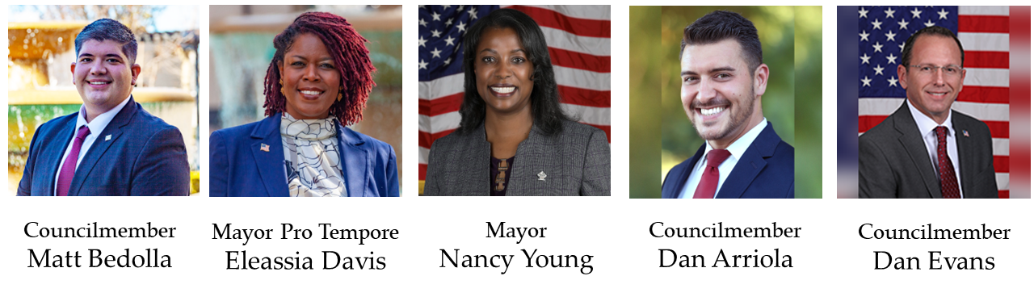
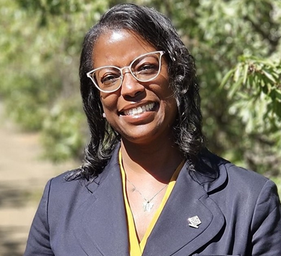

Your Tracy City Council
Councilmember
Mateo Bedolla
City Treasurer
Ray McCray
Notes:
I would also like to acknowledge our Tracy City Council: Mayor Nancy Young (who will join me here on stage later), Mayor Pro Tempore Eleassia Davis, and Council Members Dan Arriola, Matt Bedolla, and Dan Evans… along with our City Treasurer Mr. Ray McCray - please give them a round of applause.
[Applause]

Slide 8
STATE OF THE CITY 2024
Planting the SEEDS of Success
Presented by
Notes:
I would like to thank the officials and representatives from the state and county who have joined us this morning:
I’ve added some current 2024 information…
I would like to thank the officials and representatives from the state and county who have joined us this morning:
San Joaquin Supervisor Robert Rickman
Melissa Santos , representing Congressman Josh Harder’s Office
Now, I would like to ask Apostle Dr. Cynthia Chess of Mountain’s Hope Community Worship Center to lead the invocation.
[Invocation]
Thank you, Dr. Chess.
Please stand for the Presentation of Colors by the Merrill West High School Air Force JROTC Cadet Lieutenant Colonel Jessica Perez.
[Jessica Speaks from Script]
I would like to welcome Bailey Poole to the stage, who will be singing the National Anthem and Reece Dent to the stage who will sing the Negro National Anthem.
***SHUTTER PROJECTOR***
[Colors get posted, National Anthem]
Thank you. [Guests Exit]
*CLICK TO TRACY CONNECTS SLIDE*
Thank you. [Guests Exit]
*CLICK TO TRACY CONNECTS SLIDE*

Slide 9
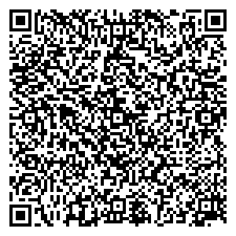

Upcoming Events
4th of July Fireworks Show – July 4, 2024, Legacy Fields
Annual Golf Tournament – August 26, 2024
Candidate Forum – August 2024
4th Annual Tracy Connects – September 21, 2024
Spain and The Costa Del Sol Trip – October 20–28, 2024
Annual Community Awards Gala – January 31, 2025
Stay in Touch:
www.TracyChamber.org
(209) 835-2131
Scan to sign up for weekly updates!
Notes:
Here are some upcoming events to look forward to – sign up to receive our weekly updates by visiting TracyChamber.org!
Now, I would like to introduce our guest speaker.
*CLICK TO IMEL BIO*

Slide 10
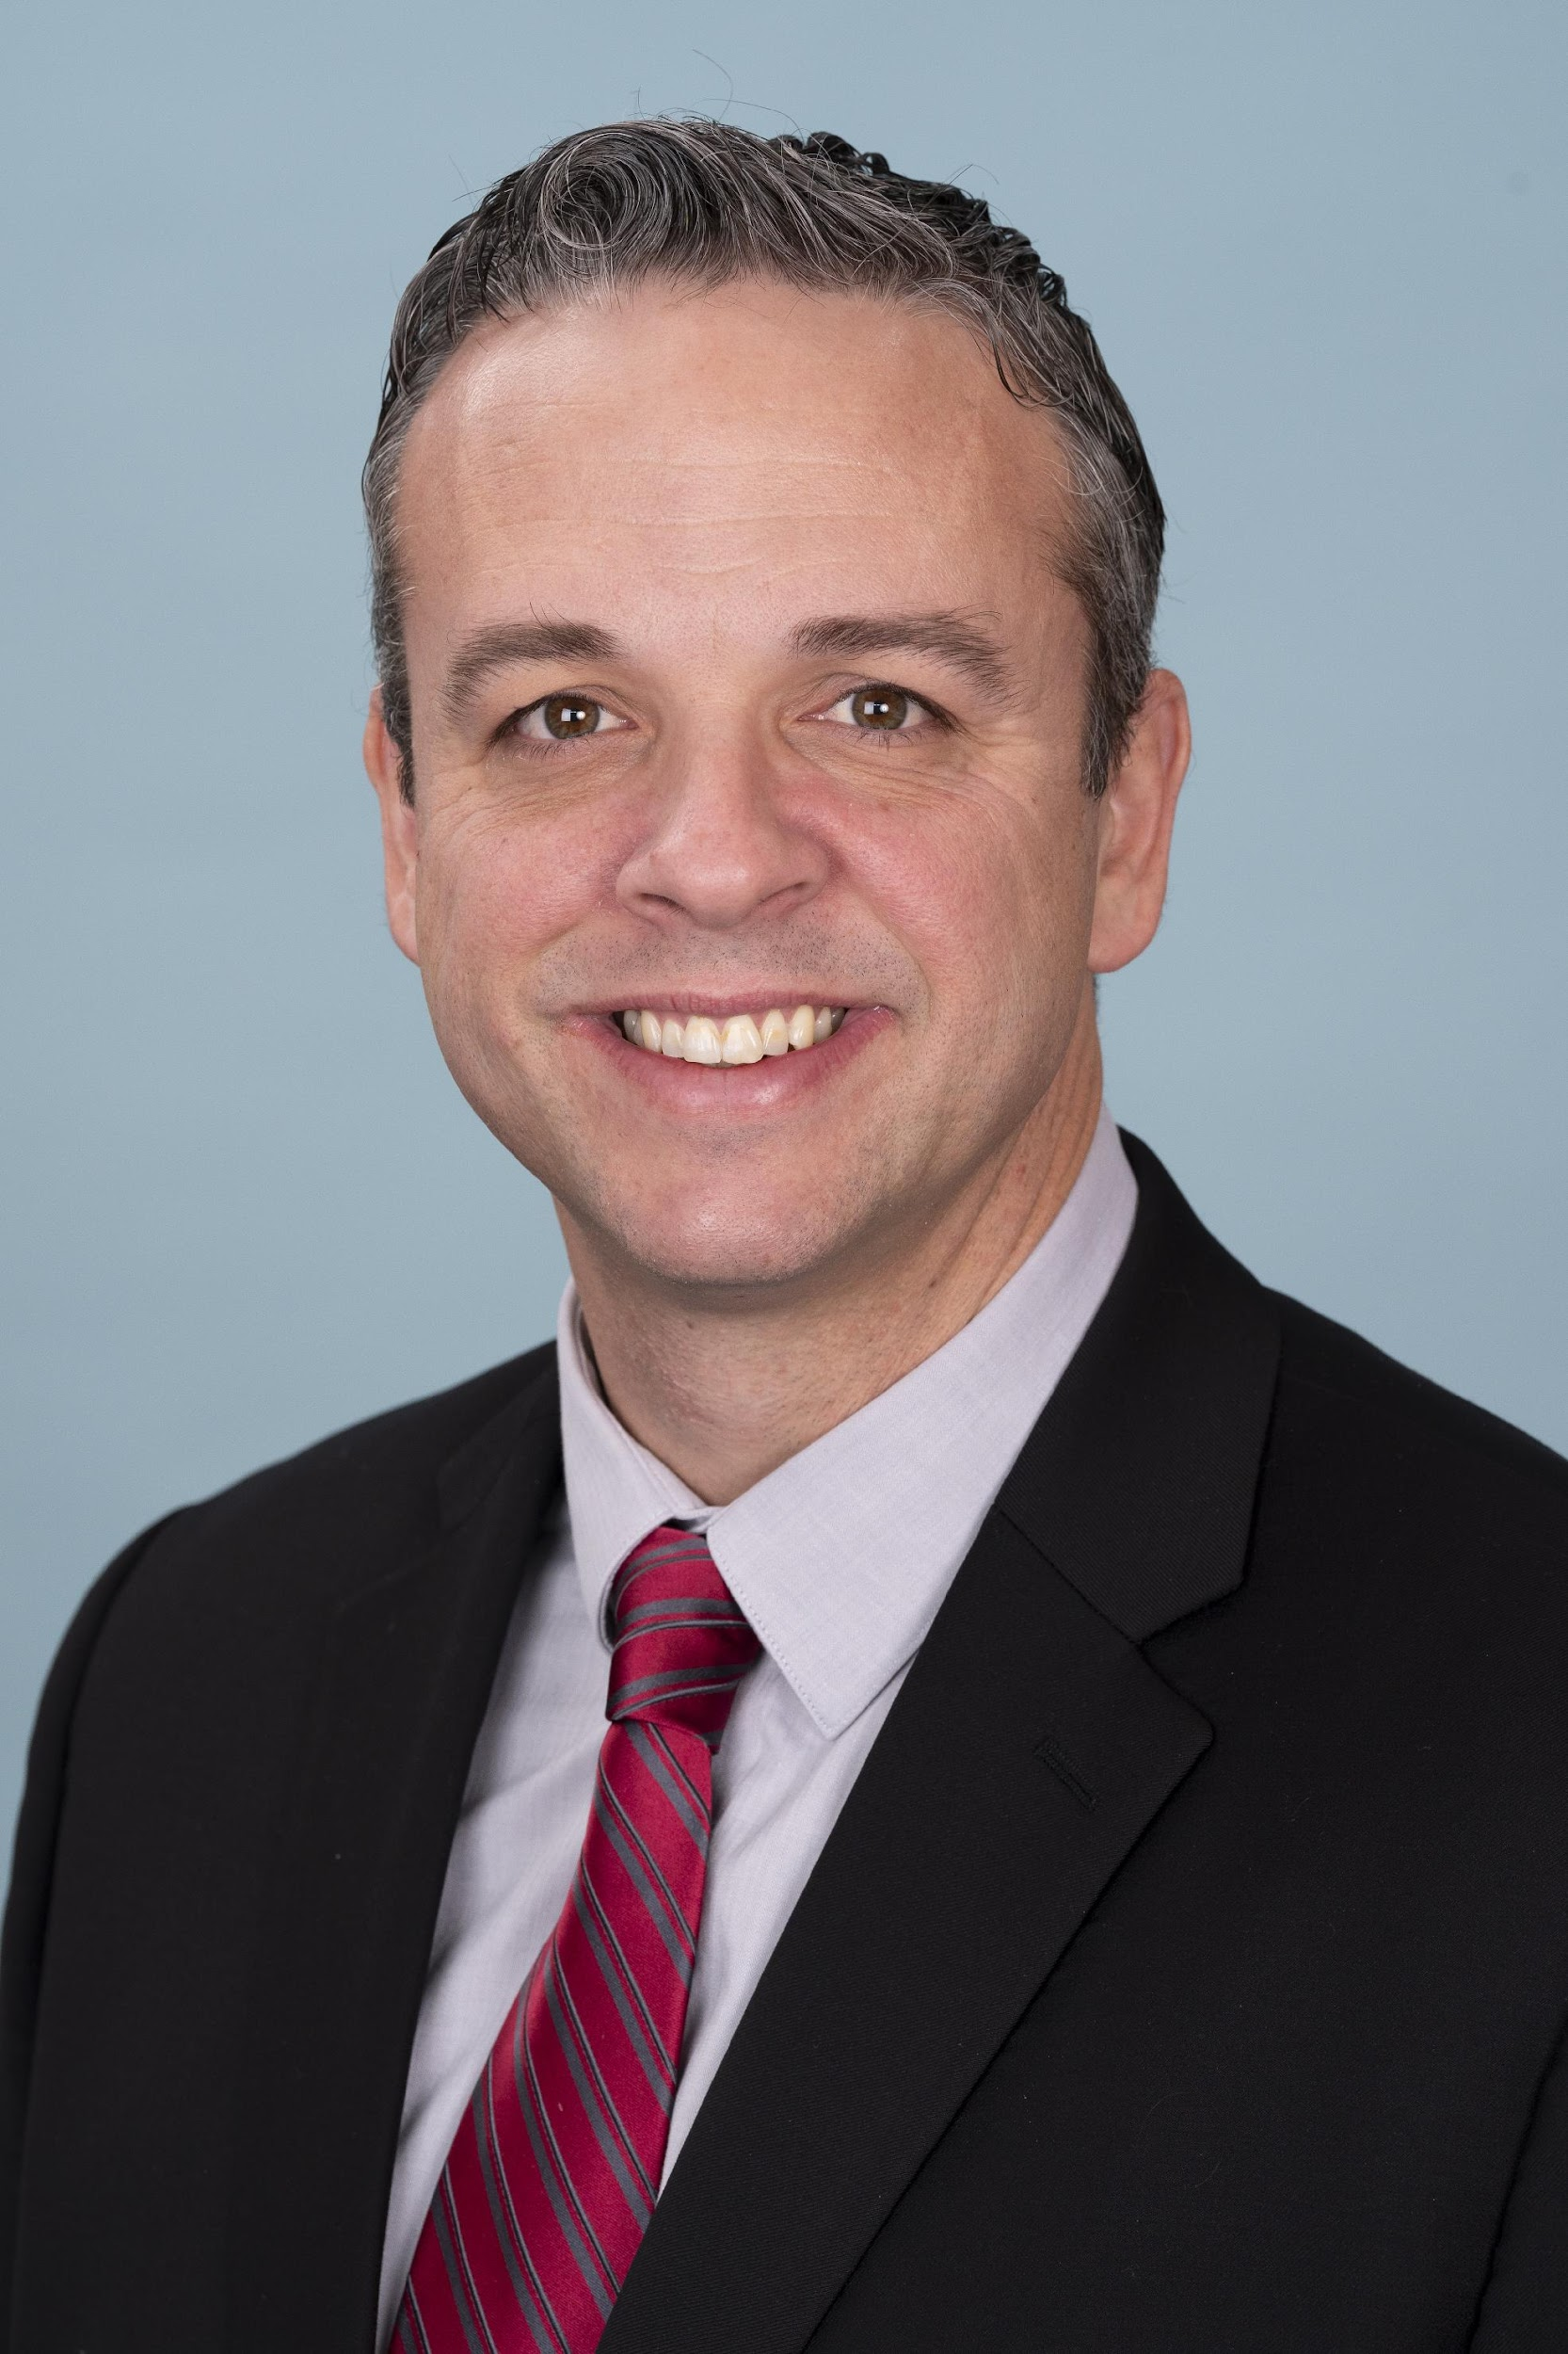
Jennings Imel
Vice President, Congressional and Public Affairs
U.S. Chamber of Commerce
Notes:
Jennings Imel is vice president of the Western Region in the Government Affairs Division at the U.S. Chamber of Commerce. The office is responsible for legislative and political grassroots activities in Arizona, California, Hawaii, Nevada, and Utah in support of the Chamber’s national public policy goals. Before joining the U.S. Chamber in 2013, Jennings worked in Washington, D.C., at the U.S. Association of Former Members of Congress and at the public affairs firm Mercury, Clark & Weinstock. Earlier, he worked in the California State Assembly and managed and worked on several successful congressional and state legislative campaigns, mostly in Southern California. Jennings received a master’s degree in international affairs from The George Washington University and bachelor’s degrees in political science and German from the University of California, Riverside.

Slide 11
2024 Small Business Outlook
Assessing the economic and policy landscape

Slide 12
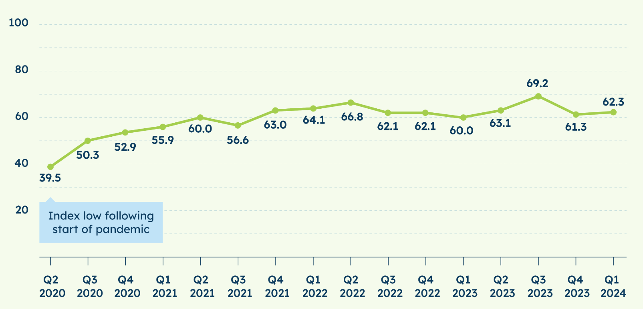
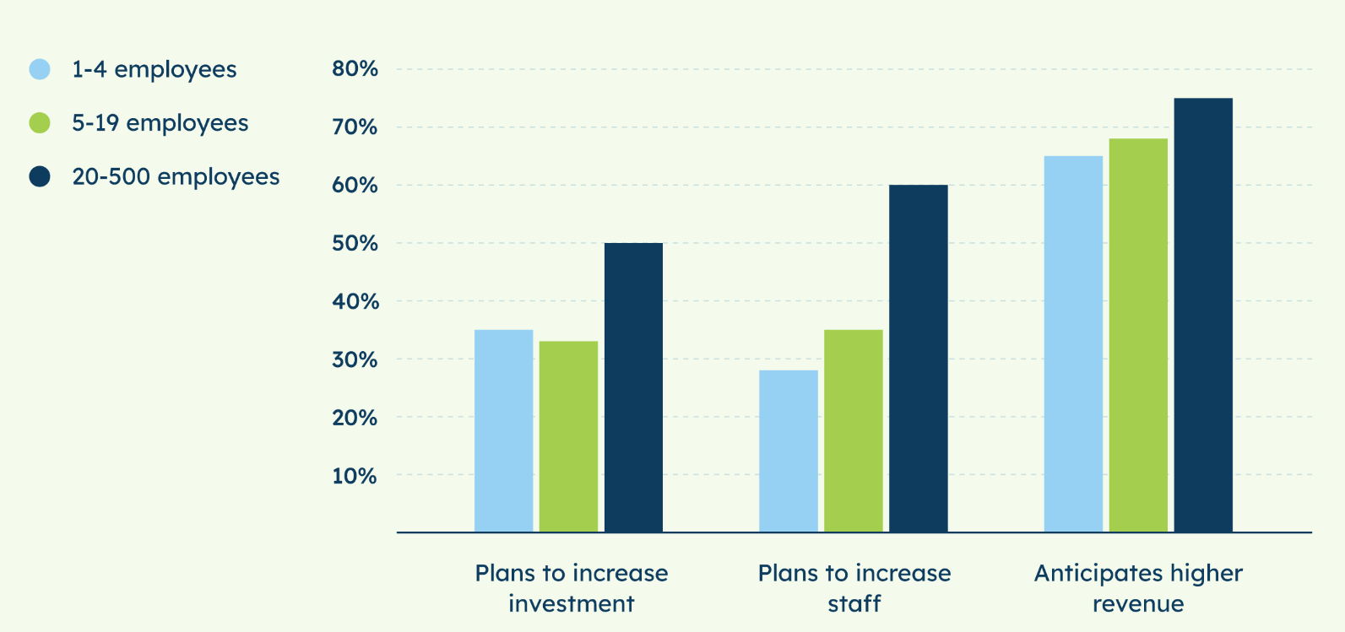
The State of Small Business
U.S. Chamber / MetLife Small Business Index: Key Findings from 2024 Q1
65% say their business is in “good health”
32% say national economy in “good health”
High confidence in revenue growth
Low confidence in investment & hiring
Inflation remains top concern
U.S. Chamber Small Business Index: 2024 Q1
Expectations for the next year (by business size)

Slide 13
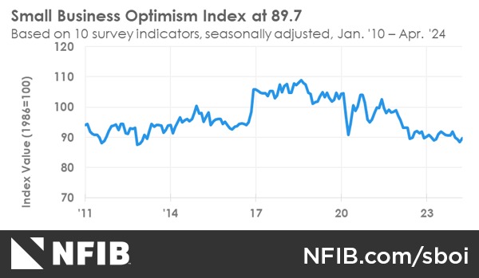
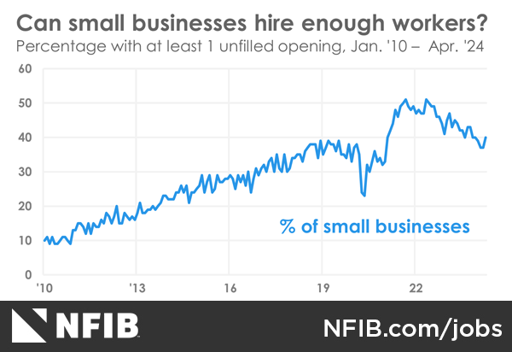
The State of Small Business
NFIB: Small business optimism lowest since 2012!
56% looking to hire
91% have few or no qualified candidates

Slide 14
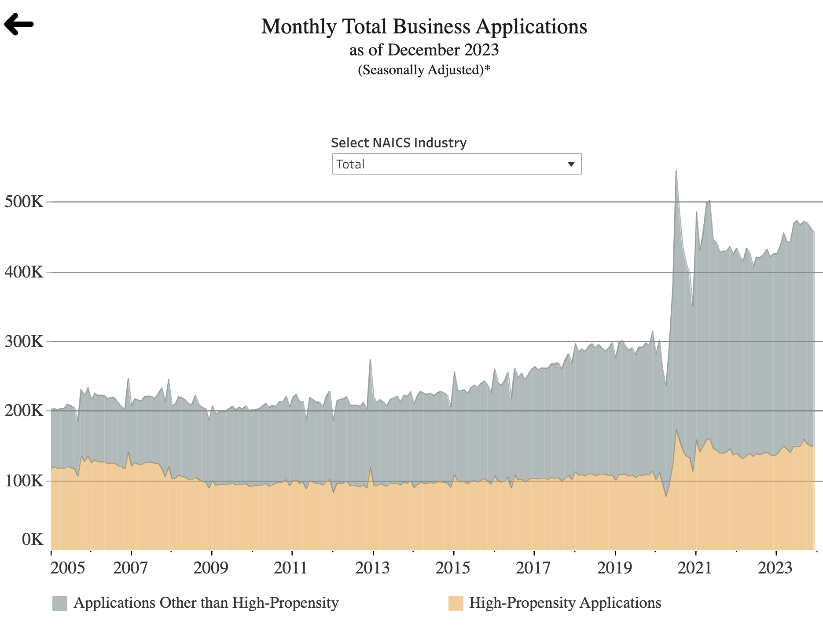
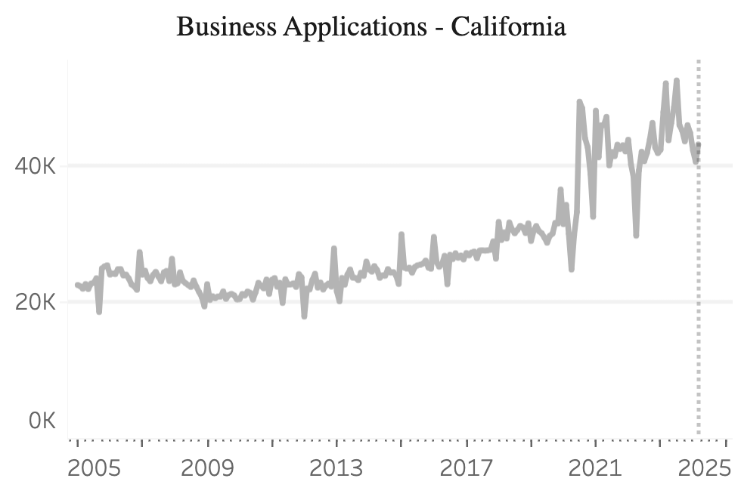
The State of Small Business
558,011 new applications in 2023 (7.8% growth)

Slide 15
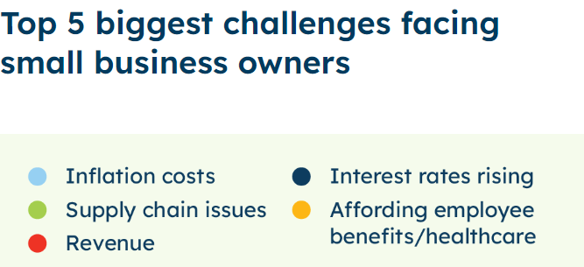
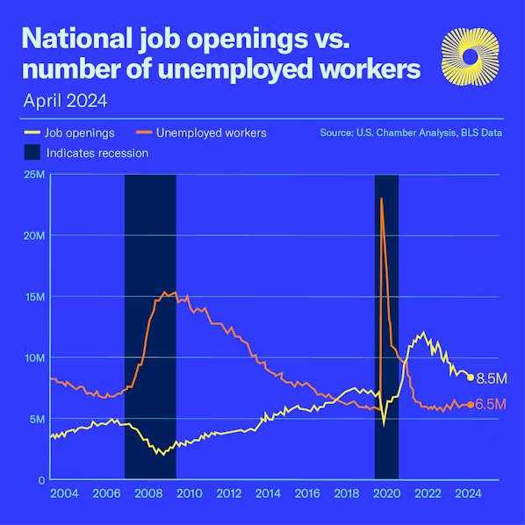
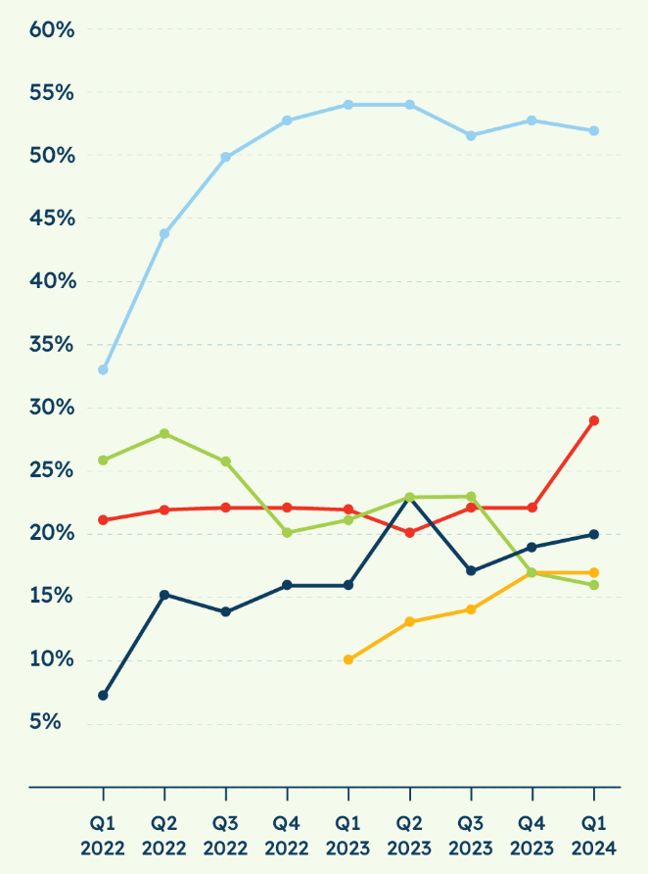
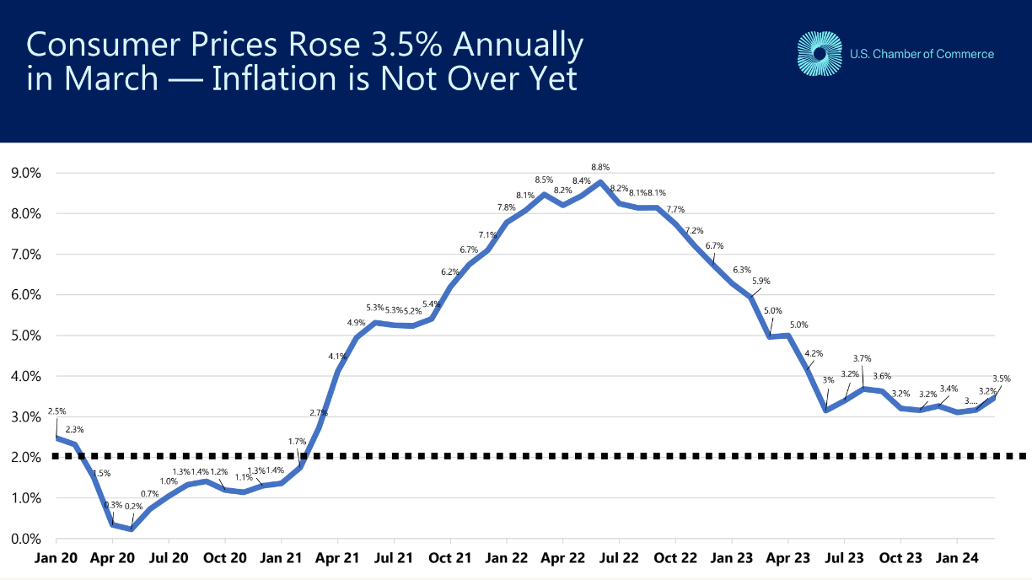
Top Concerns for Small Business
Inflation / Cost of Doing Business
52% cite inflation as top challenge
Costs in CA 42% higher than national average
Policy Solutions: Tax / Regulatory Reform / Energy
Worker Shortage
53% cite worker shortage in their area
WAR in CA: 0.92
Policy Solutions: Childcare / Immigration
Retail Crime
Losses in CA (2021): $19.1 billion
Lost tax revenue in CA (2021): $3.4 billion
Policy Solutions: Aggregation / Coordination / Prosecution

Slide 16
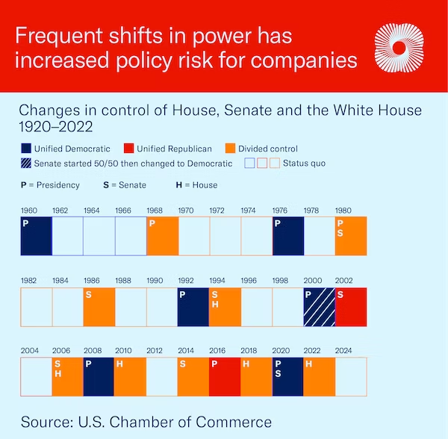
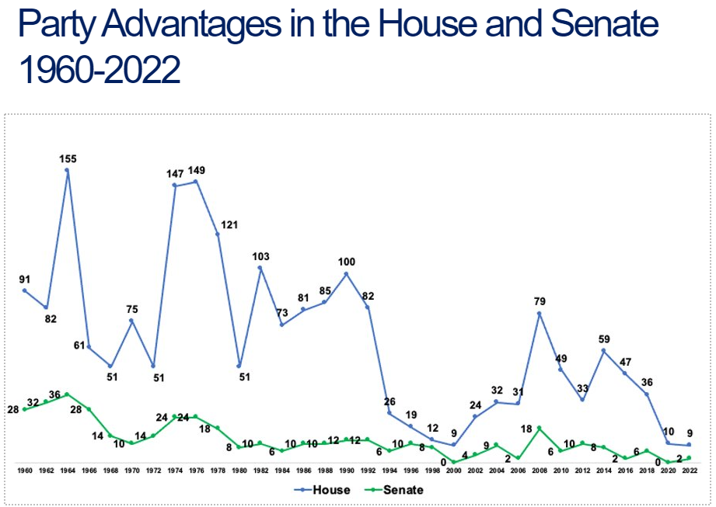
Small Businesses See Growing Policy Risks
Election trends have heightened risks for businesses
Partisan gridlock in Congress
The rise of one-party supermajorities in the states

Slide 17
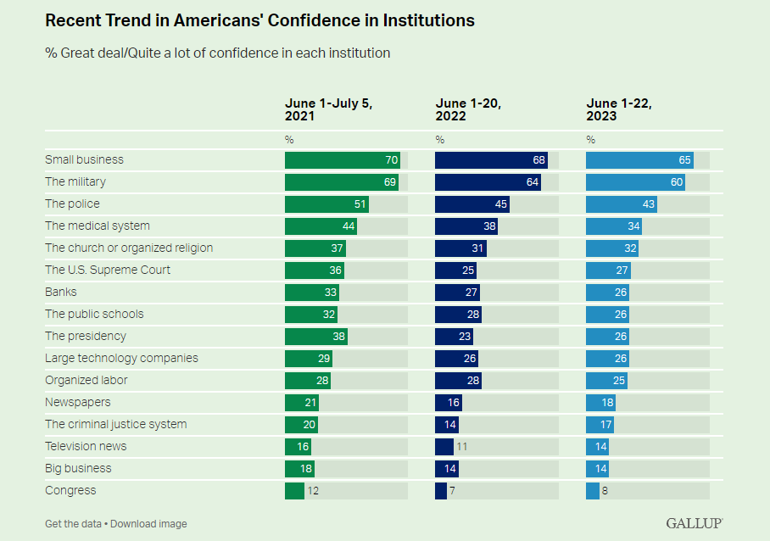
Advocacy Agenda for Small Business
Tax Relief for American Families and Workers Act
Main Street Tax Certainty Act
Prove It Act
Promote and Defend Free Enterprise
Americans trust small business!

Slide 18
Thank you
Jennings Imel
Vice President, Western Region
U.S. Chamber Government Affairs
jimel@uschamber.com
818-321-1883

Slide 19
STATE OF THE CITY 2024
Planting the SEEDS of Success
Growing from our past; Nurturing for our future
Presented by
Notes:
Thank you for joining us today to share your insights, Jennings. We really appreciate your time and your insights. And now…
*CLICK TO MAYOR INTRO*

Slide 20
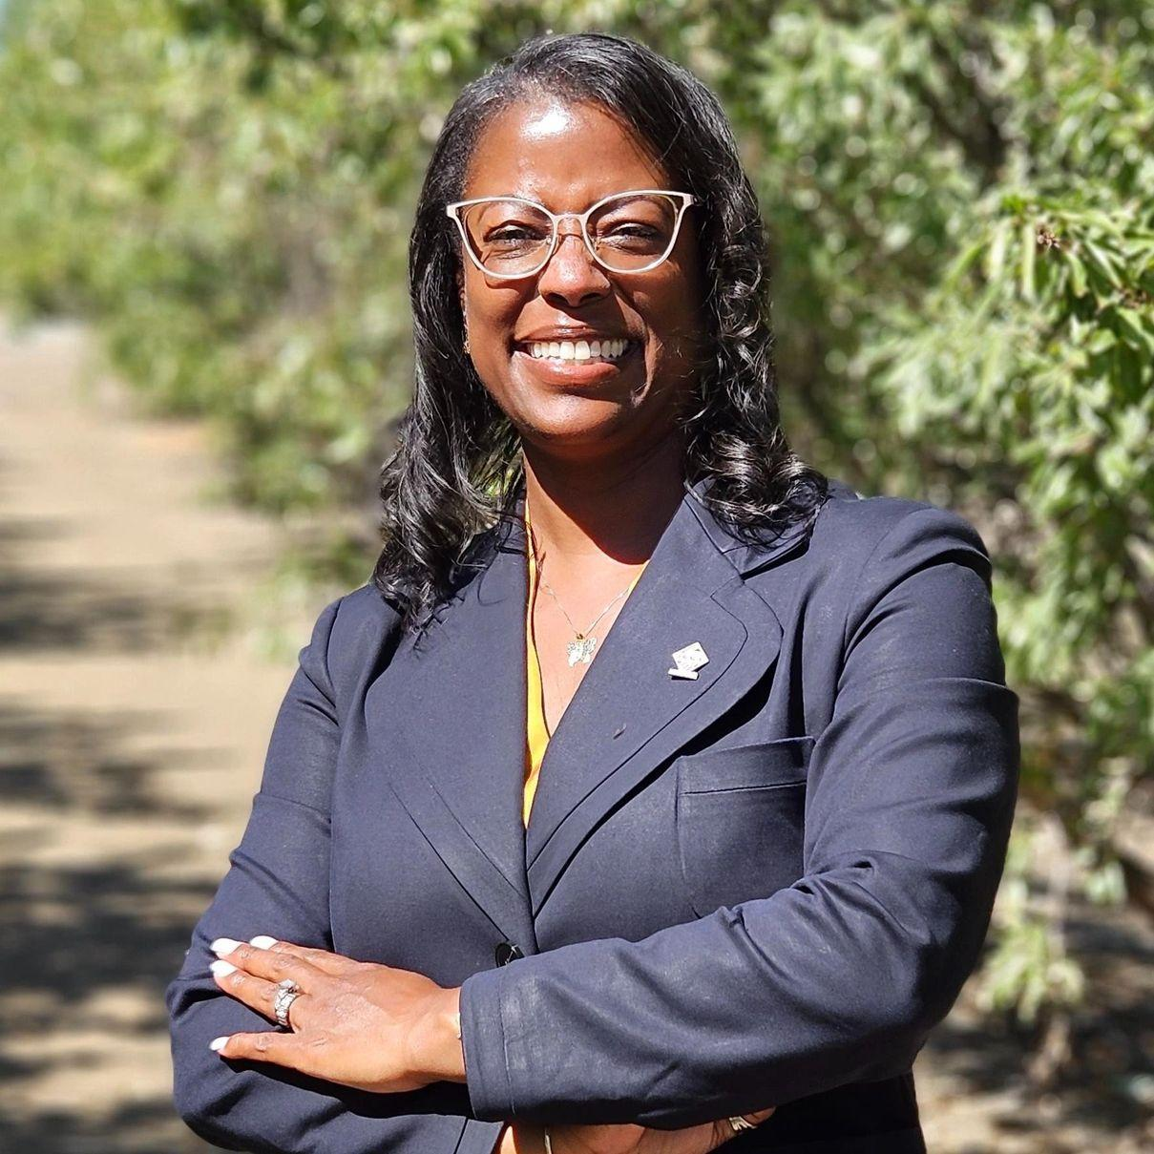
Dr. Nancy Young
Mayor
Notes:
Maria: I would like to introduce our next speaker.
Dr. Nancy Diane Young was re-elected as Mayor in November 2022. Prior to becoming Tracy’s first direct elected woman AND first African American to be elected as Mayor in 2020, she served for eight years on our Tracy City Council as a Council member and Mayor Pro Tempore. She is committed to preserving our safe, family-oriented community, and is a staunch advocate for affordable housing. She is passionate about serving our youth, workforce preparedness, and addressing the needs of our Tracy seniors. She has been focused on bringing new businesses and jobs to Tracy, while nurturing existing businesses – efforts that we at The Chamber are proud to partner with the City on, Please welcome our Mayor, Dr. Nancy Young to the stage.
[Establish at rehearsal which side of the stage the Mayor will enter and whether she and Maria will shake hands or hug]

Slide 21
STATE OF THE CITY 2024
Planting the SEEDS of Success
Growing from our past; Nurturing for our future
Presented by
Notes:
Thank you, Maria. Good morning, everyone! It is with great pride and optimism that I stand before you today to deliver my final State of the City address with the theme: “Planting the Seeds of Success: Growing from our past; Nurturing for our future”.
It has been my honor to serve you over the last 12 years. I am proud to have always considered the following three things when it came to making policy decisions at the dais:
Our history, from the discussions and decisions of those who served on Council before me,
to All of you, our constituents, businesses, and visitors - to amplify YOUR voices. “Building Community Together!”
And lastly, Vision for our future, planting the SEEDS of Success, year after year.
Tracy's rich history and strategic location have long served as the foundation of our prosperity. Like the roots of a mighty tree, they anchor us to our past while nourishing our growth into the future.
[CLICK]

Slide 22
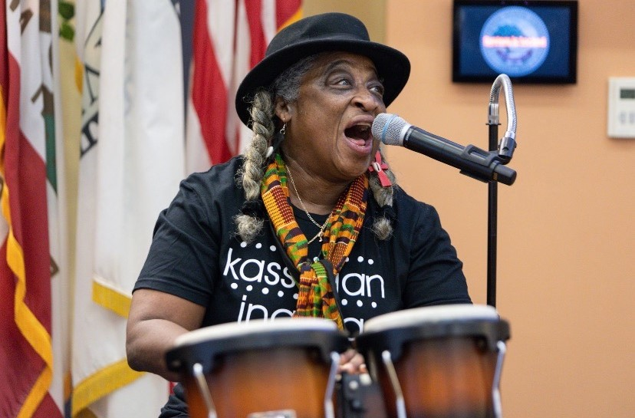
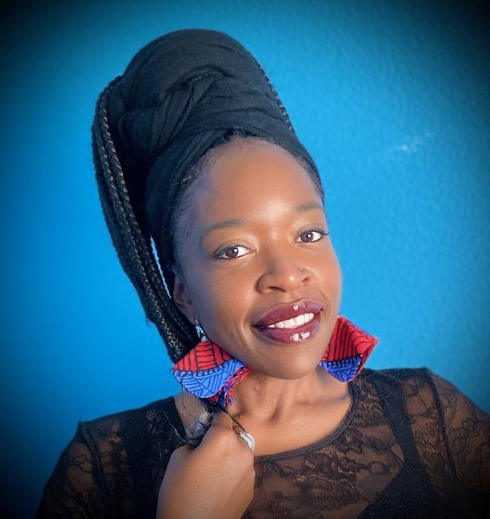
🌱 “Still I Rise” Cultural Interlude
On Drum: “Tovia Drum”
Rendition of ”Still I Rise”
by Maya Angelou:
Kehia McKinney
Notes:
Now, let us enjoy a bit of entertainment and mental stimulation as I welcome to the stage:
Ms. Tovia Drums on the drum as we get into rhythm to be on one accord, in unity as we honor our past and journey to our future.
and… Kehia McKinney as she shares one of my favorite and powerful poems from Maya Angelou, Still I Rise!
[CLICK]

Slide 23
🌱 Planting the SEEDS of Success: Growing from our past; Nurturing for our future
“Those who don't know history are doomed to repeat it.” (Edmund Burke)
“If you don't know history, then you don't know anything. You are a leaf that doesn't know it is part of a tree.” (Michael Crichton)
“Be not deceived: God is not mocked, for you reap whatever you sow.“ (Paul, Galatians 6:7)
Notes:
Thank you ladies.
Now that we’re focused…Let’s turn our attention to our theme: Planting the SEEDS of Success: growing from our past; nurturing for our future.
Today, I plan to trace almost 150 years of history of Tracy to where we are today, so we can better understand how to grow the success of tomorrow.
Knowing our history is important. (Look at slide)
“Those who don't know history are doomed to repeat it.” (Edmund Burke)
“If you don't know history, then you don't know anything. You are a leaf that doesn't know it is part of a tree.” (Michael Crichton)
"Be not deceived: God is not mocked, for you reap whatever you sow.“ (Paul, Galatians 6:7)
[CLICK]

Slide 24
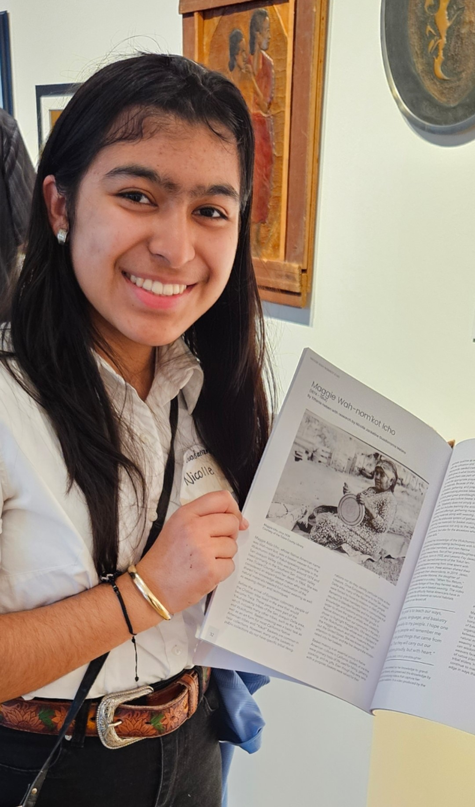
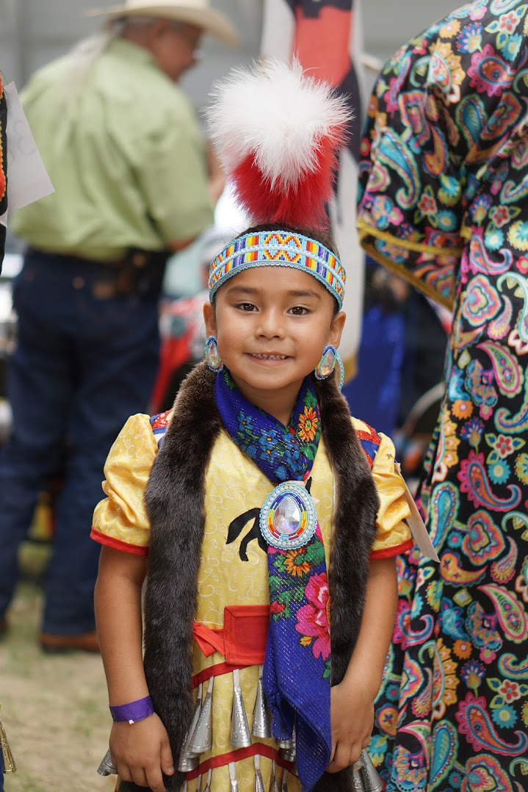
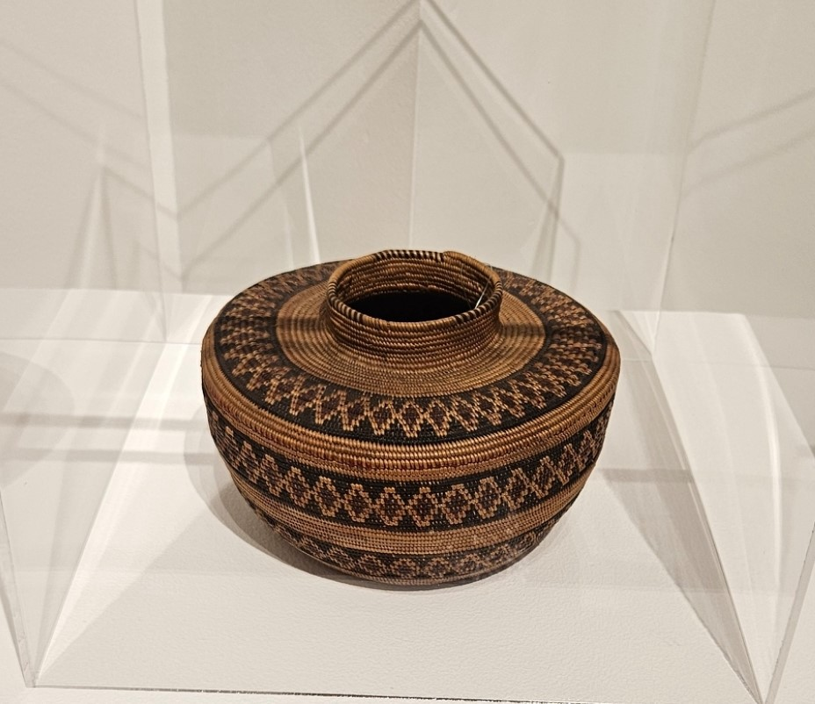
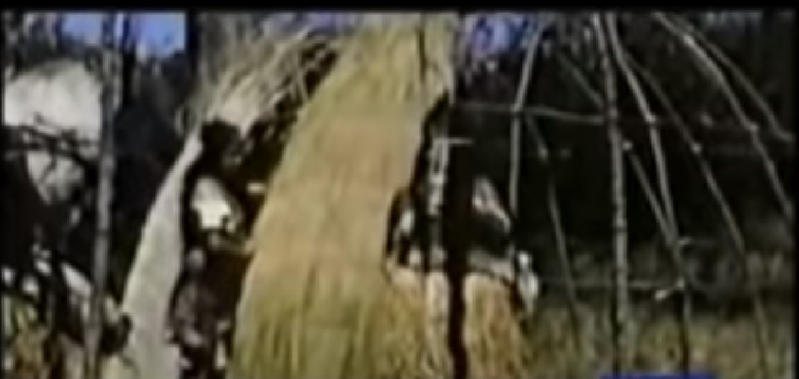

🌱 Planting the SEEDS of Success: Growing from our past; Nurturing for our future
Native American Tachi-Yokuts
Notes:
Every tree start with the foundational roots.
We want to acknowledge the Native American Yokut Tribe who were indigenous to Tracy and the rich soil on which they provided from which the roots of Tracy were planted.
The Tachi-Yokut lived for hundreds of years in the Delta, grasslands and foothills around Tracy. Eventually, the Yokuts were displaced by the settlers and fell victim to their diseases. By the late 1800s their traditional way of life was mostly gone. There are however, some of the Yokut Tribe who still live in Tracy today. Some of their artifacts are found in the Tracy Historical Museum and the Grand Theatre.
[CLICK]

Slide 25

🌱 Planting the SEEDS of Success: Growing from our past; Nurturing for our future
Embracing our History and Future: “Think Inside the Triangle”
“Live Inside the Triangle”
“Grow Inside the Triangle”
“Work Inside the Triangle”
“Learn Inside the Triangle”
Notes:
Today, we can trace the branches of Tracy from its foundation to the present, trending to an outlook for our future. Although current branding for Tracy did not happen until around 2010, and the flags that line our downtown and 11th Street came around 2015. The framing of Tracy and growth along with the town into a city can be ascribed to its current theme: “Think Inside the Triangle” from which we can clearly see the history, present and future of each branch:
Branches:
“Live Inside the Triangle”
“Grow Inside the Triangle”
“Work Inside the Triangle”
“Learn Inside the Triangle”
[CLICK]

Slide 26
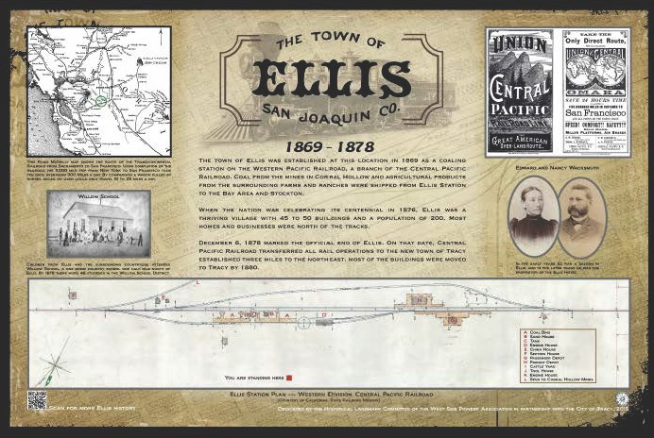
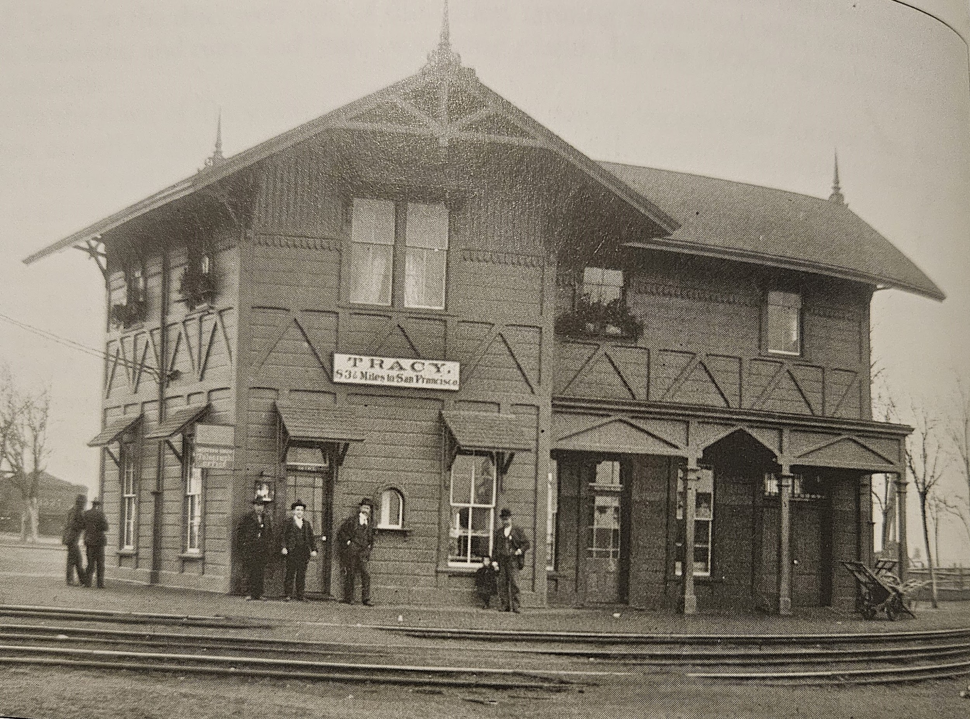
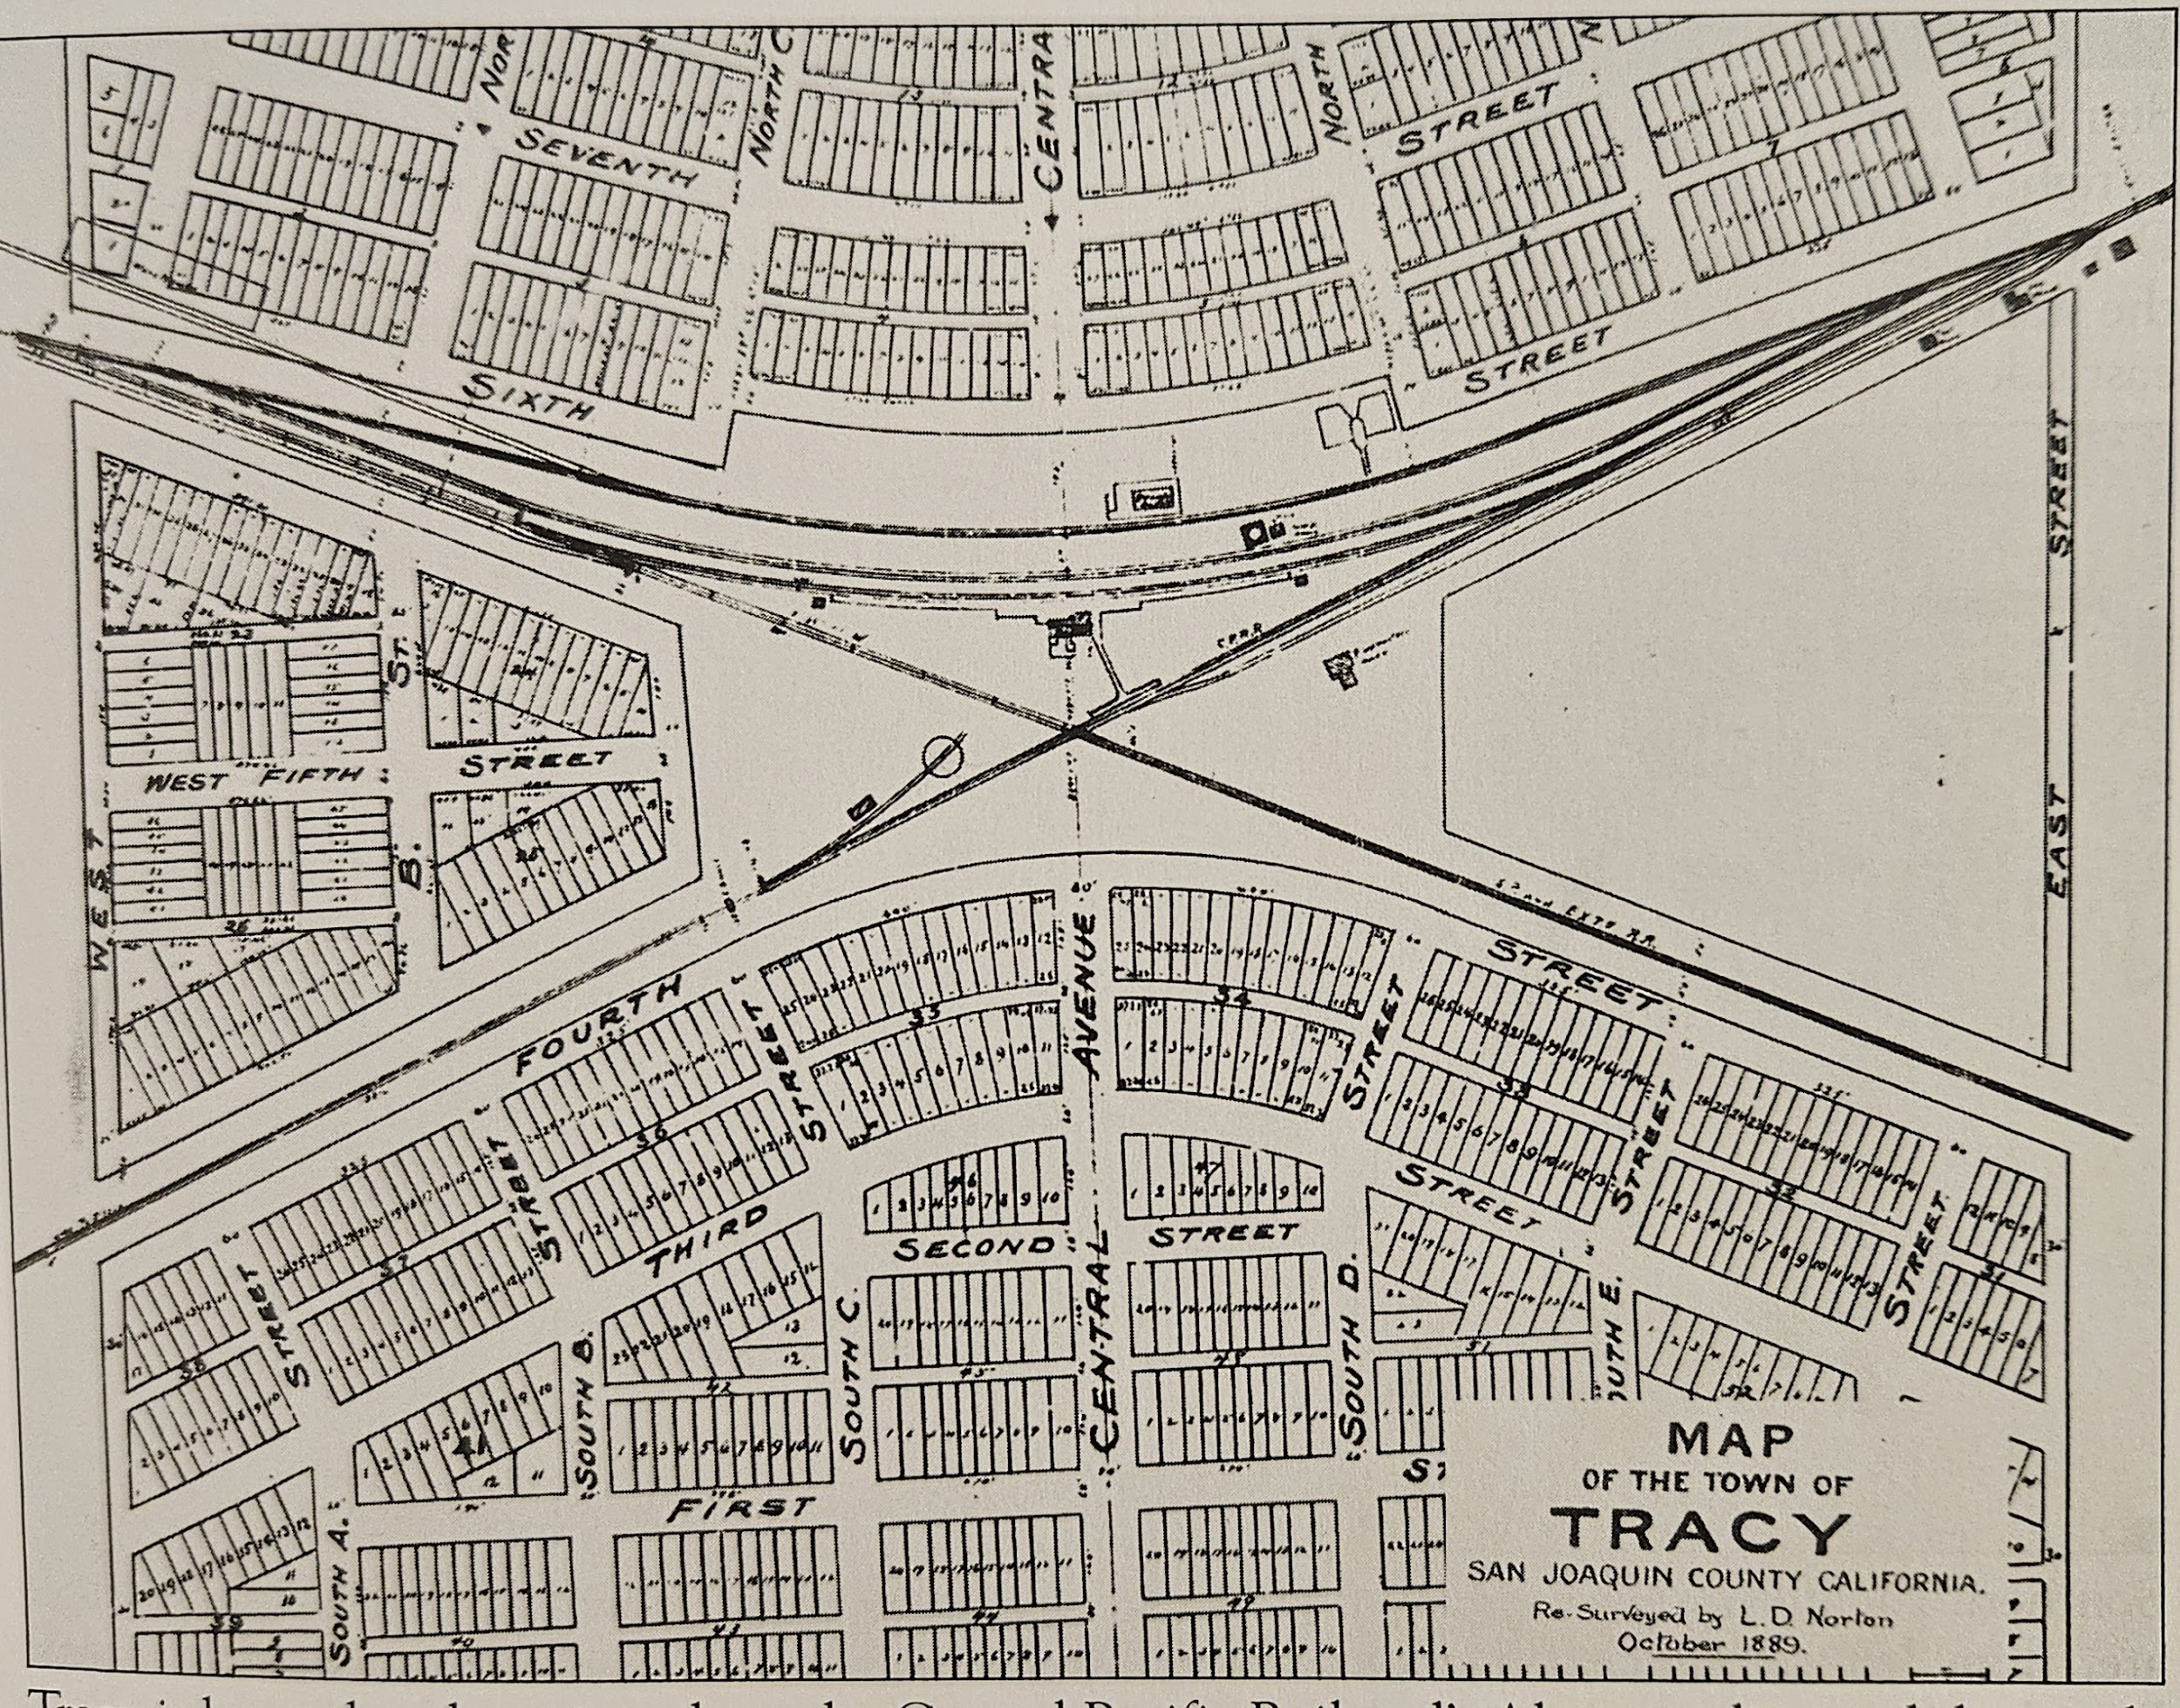
Planting the SEEDS of Success: Growing from our past; Nurturing for our future
“Live Inside the Triangle”
Ellis Town 1869-1878 Moved to New Town of Tracy Founded September 8, 1878
Notes:
After California became a state in 1850, many people from the East Coast and immigrants to America came to California for a chance to work and to homestead
In the late 1860s, there was a rush to finish the Transcontinental Railroad and to build the rail lines throughout California. The first rail line in Tracy ran from Sacramento to San Francisco and was completed in 1868. 1869, a coaling station named Ellis was built at the foot of the Altamont to load extra coal needed to fuel the trains. This became of the Town of Ellis 1869-1878.
In 1878 a second rail line was built from San Francisco to Fresno was built through Tracy. At that time, the wood buildings in Ellis were loaded onto horse-drawn wagons and moved 3 miles east to where the two tracks intersected at what is known as the Bowtie on what is now 6th Street and Central. This is where the new town of Tracy was planted September 8, 1878. A local railroad official named the new town after a boss he admired, Lathrop J. Tracy.
[CLICK]

Slide 27

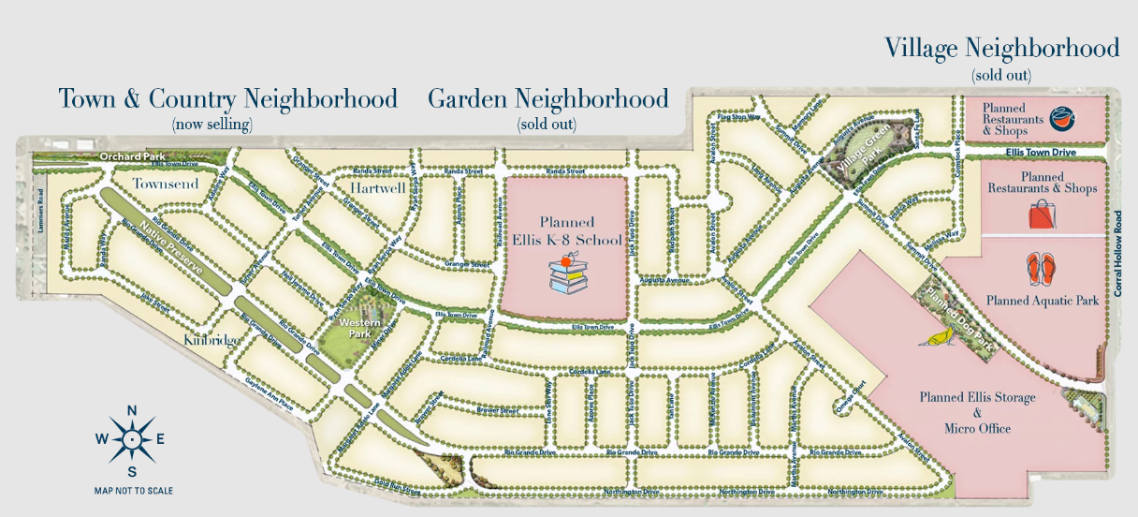
🌱 Planting the SEEDS of Success: Growing from our past; Nurturing for our future
Notes:
Preserving our Tracy Roots are important. Fast Forward - Incorporating our Ellis roots, Ellis, a Surland neighborhood is a master-planned community (building approximately 2,250 homes) in Tracy that, offers modern homes, community spaces, and amenities. Planned more than 20 years ago, Ellis, is a great place for Tracy residents to take roots.
Watch this short video to learn more about the development.
[Cue video]

Slide 28

🌱 Planting the SEEDS of Success: Growing from our past; Nurturing for our future
Notes:
[Cue video]

Slide 29

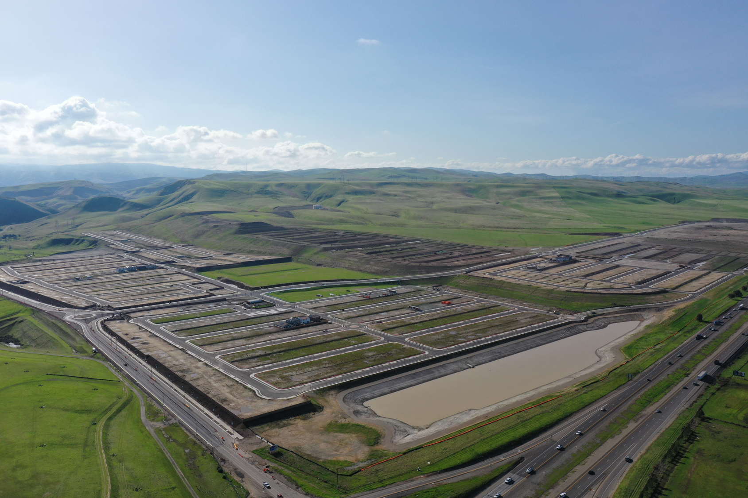

🌱 Planting the SEEDS of Success: Growing from our past; Nurturing for our future
Notes:
Another larger development that planted its roots more than 30 years ago is Tracy Hills. This development will bring approximately 5,980 new single family homes to Tracy, a growing and underserved region for housing.
Watch this short video to learn more about the development.
[Cue video]

Slide 30

🌱 Planting the SEEDS of Success: Growing from our past; Nurturing for our future
Notes:
[Cue video]

Slide 31

🌱 Planting the SEEDS of Success: Growing from our past; Nurturing for our future
Notes:
Planning for our future, we must adjust for the varied needs and desires of our community. We heard the community several years ago who wanted luxury living for 55+ Active Adults in Tracy and now it is a reality.
Regency at Tracy Lakes (Corral Hollow & Valpico) is now open. Construction began in 2021 for this gated, 55+ active-adult master-planned new home community of 600 single-story homes with lakes, a recreation center, dog park, swimming pool, and walking paths. Model homes and sales are currently underway.
[CLICK]

Slide 32
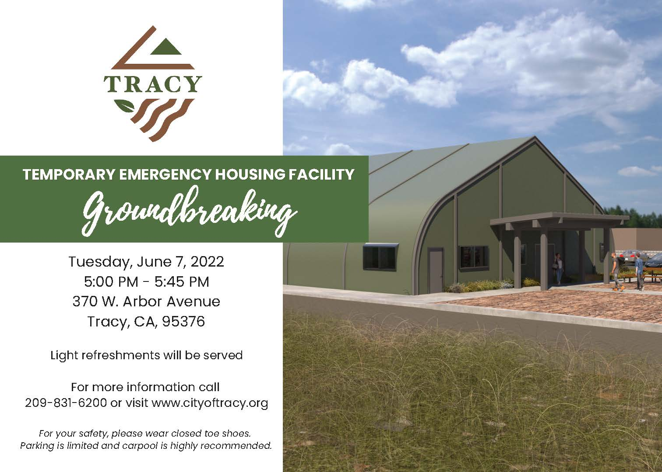
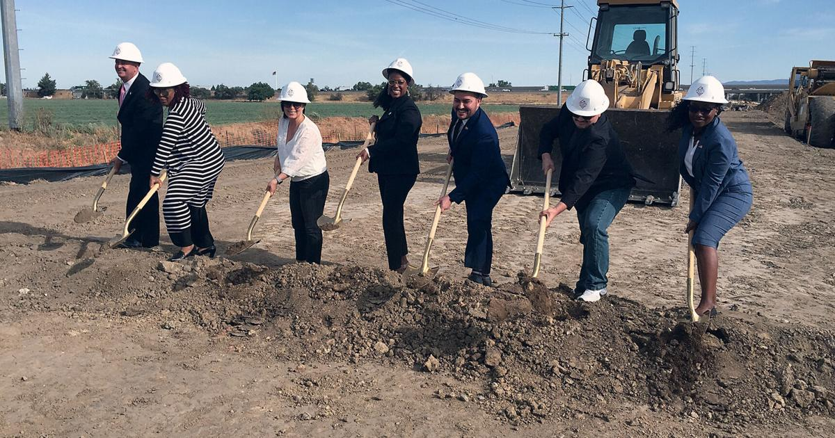
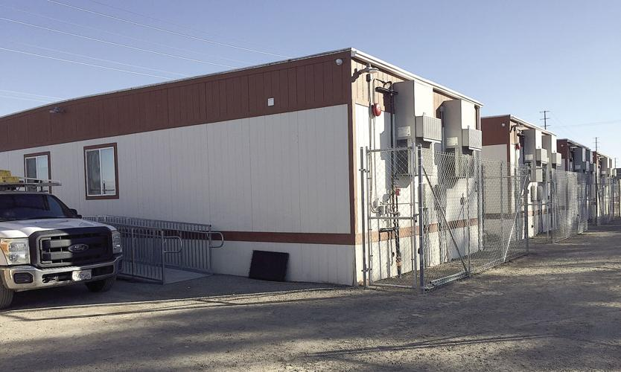
🌱 Planting the SEEDS of Success: Growing from our past; Nurturing for our future
Tracy Temporary Emergency Housing Facility Update
Notes:
Staying receptive to our community, Tracy has had to shift with the need for the unhoused. We broke ground June 7, 2022. and In November 2022, we opened our first Temporary Housing Facility. Currently we have 86 beds and expect to expand with the addition of a permanent facility in the future.

Slide 33
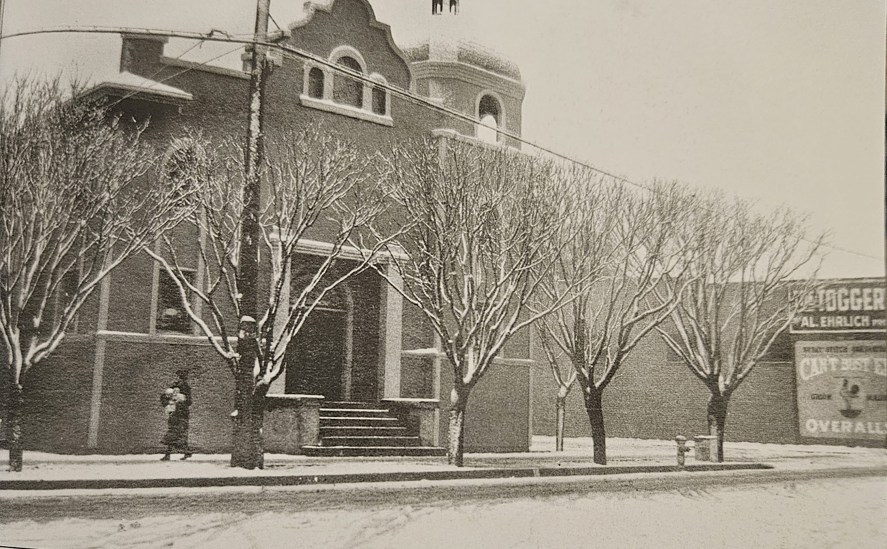
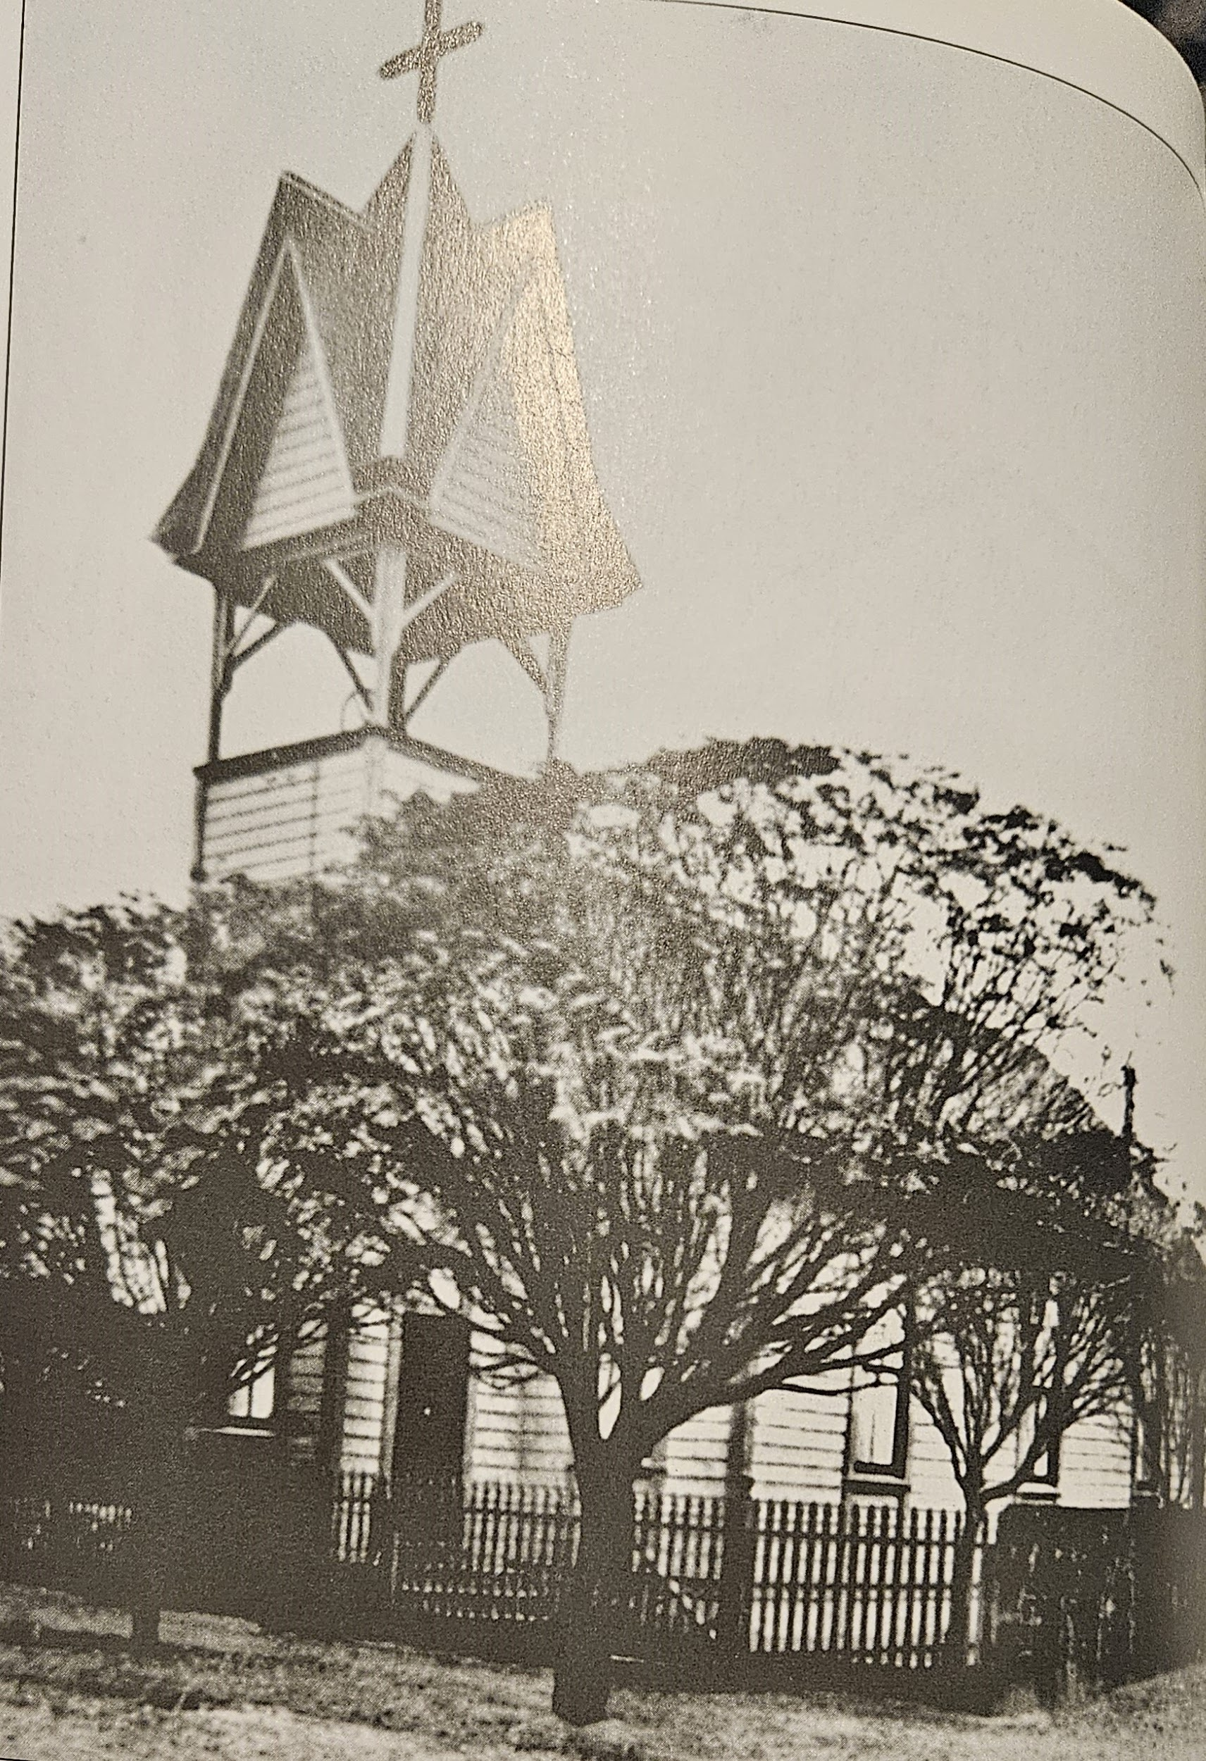
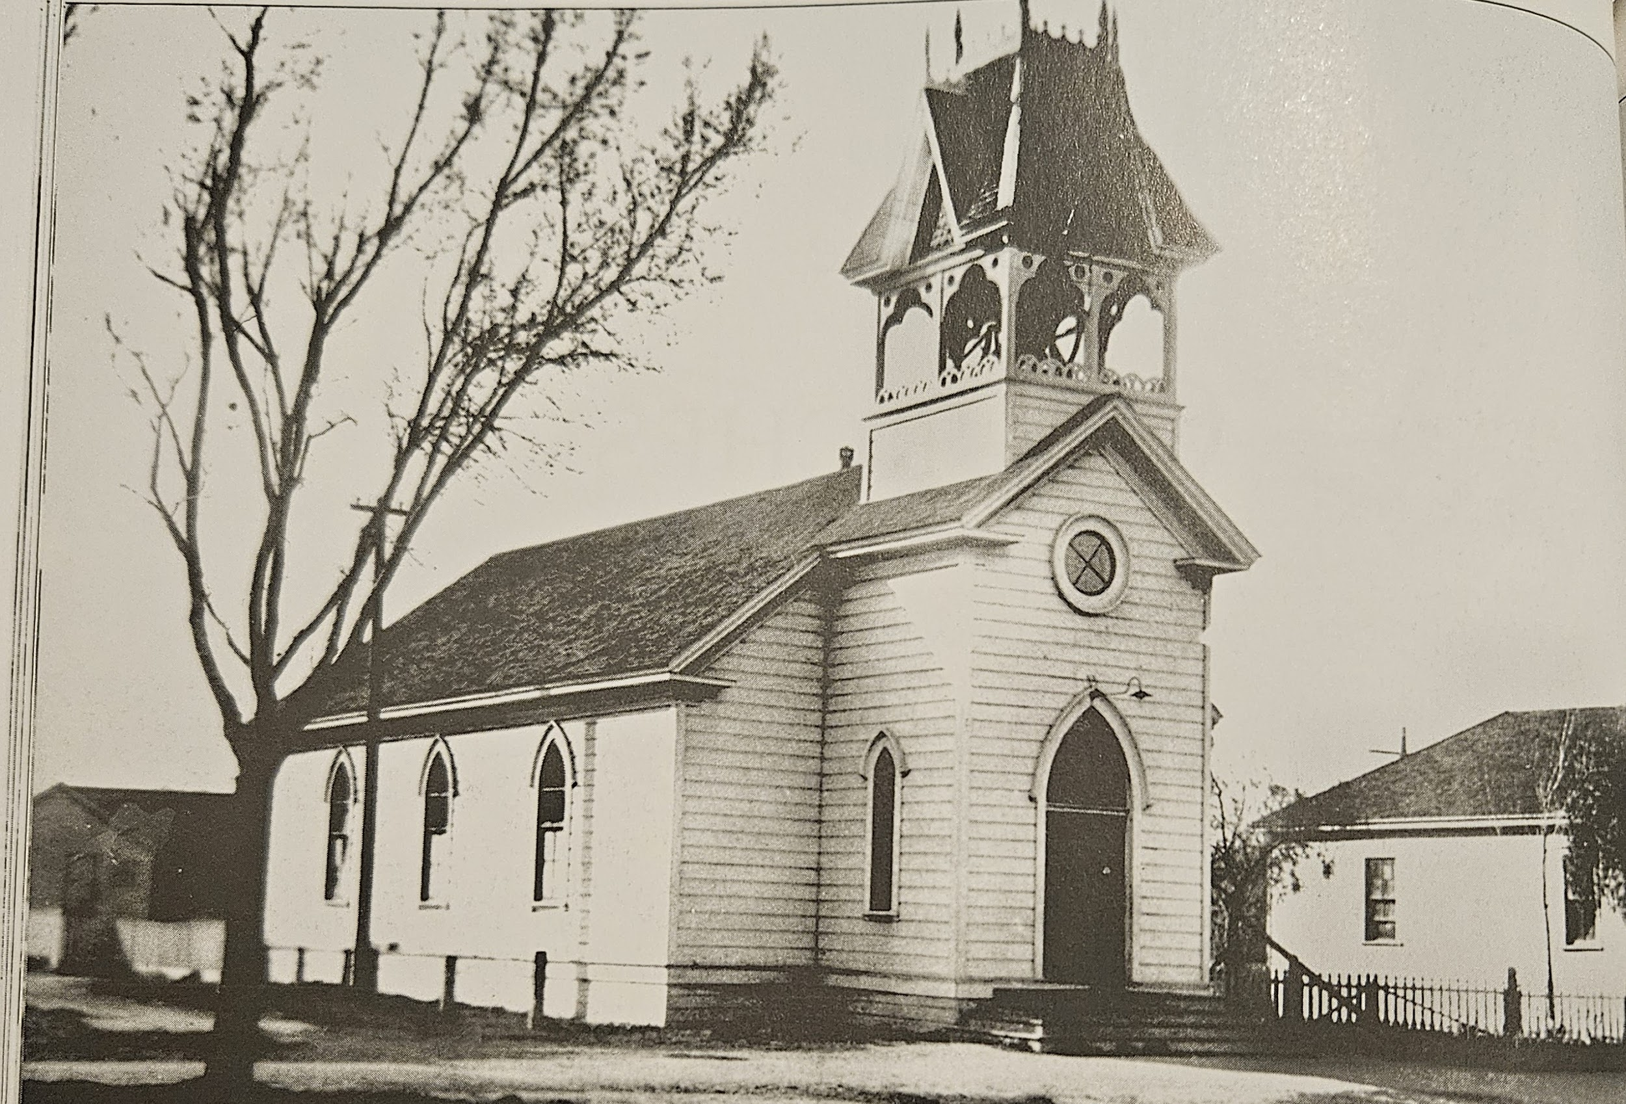
🌱 Planting the SEEDS of Success: Growing from our past; Nurturing for our future
“Live Inside the Triangle”
Notes:
A stem (leaf) that is part of the “Live Inside the Triangle” branch is “Worship Inside the Triangle.” In the little town where numerous saloons flourished, travelling ministers and priests provided spiritual stability to the early residents until they were able to organize congregations and build their own churches. The first Presbyterian Church on 9th and Central was originally founded in Ellis in April 1876 and was built and dedicated at the new site Oct 2, 1887.
The Tracy Catholic Church, located at the corner of 8th and Central was built in 1887-1888. After they became a parish in 1908, the church was named St. Bernard’s after St. Bernard of Clairvaux.
Not only were the churches the center of the community’s spiritual life, but the Presbyterian Church’s bell served as the city’s fire bell for a number of years. The Methodist church annex was used as a school classroom when Willow School became too small for the growing community and was also used as an emergency ward during the 1918 flu epidemic.
Today, churches, mosques, synagogue, and temples of numerous faiths serve the spiritual needs of the growing Tracy community, some still serving the extended educational needs of our residents
[CLICK]

Slide 34
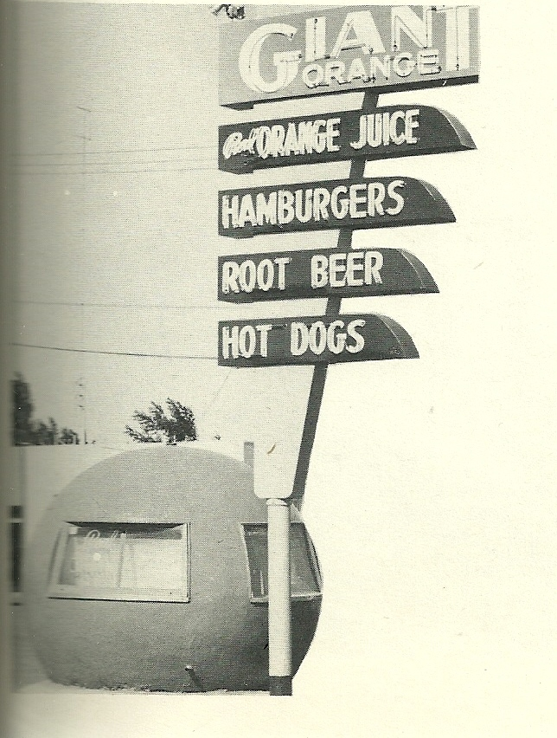
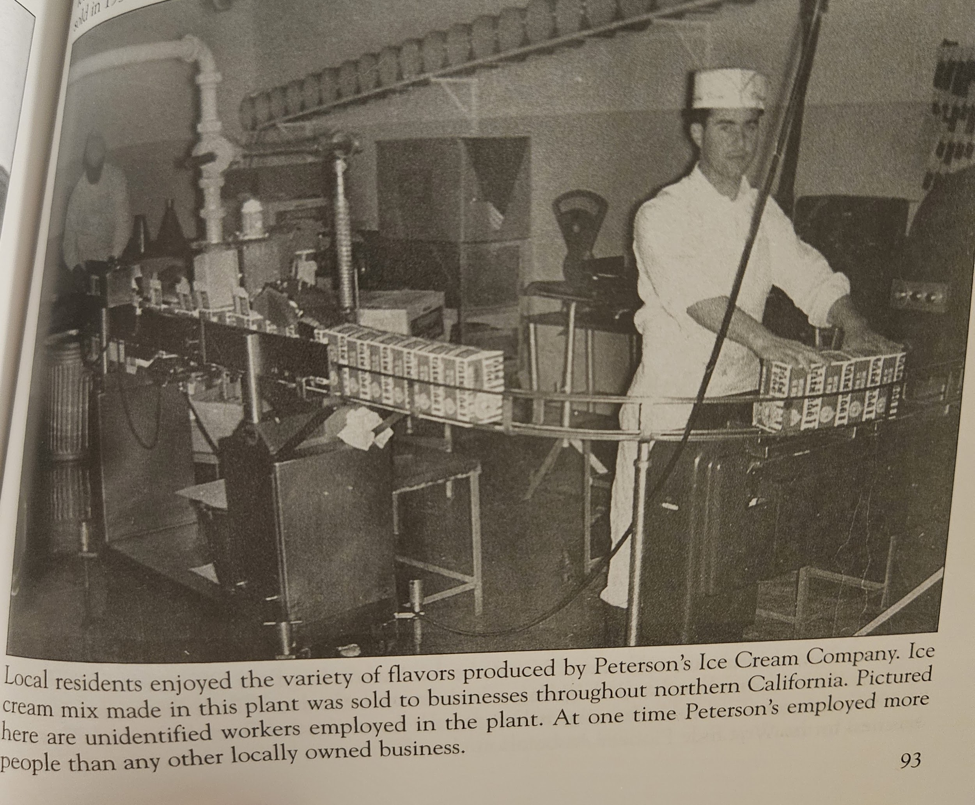
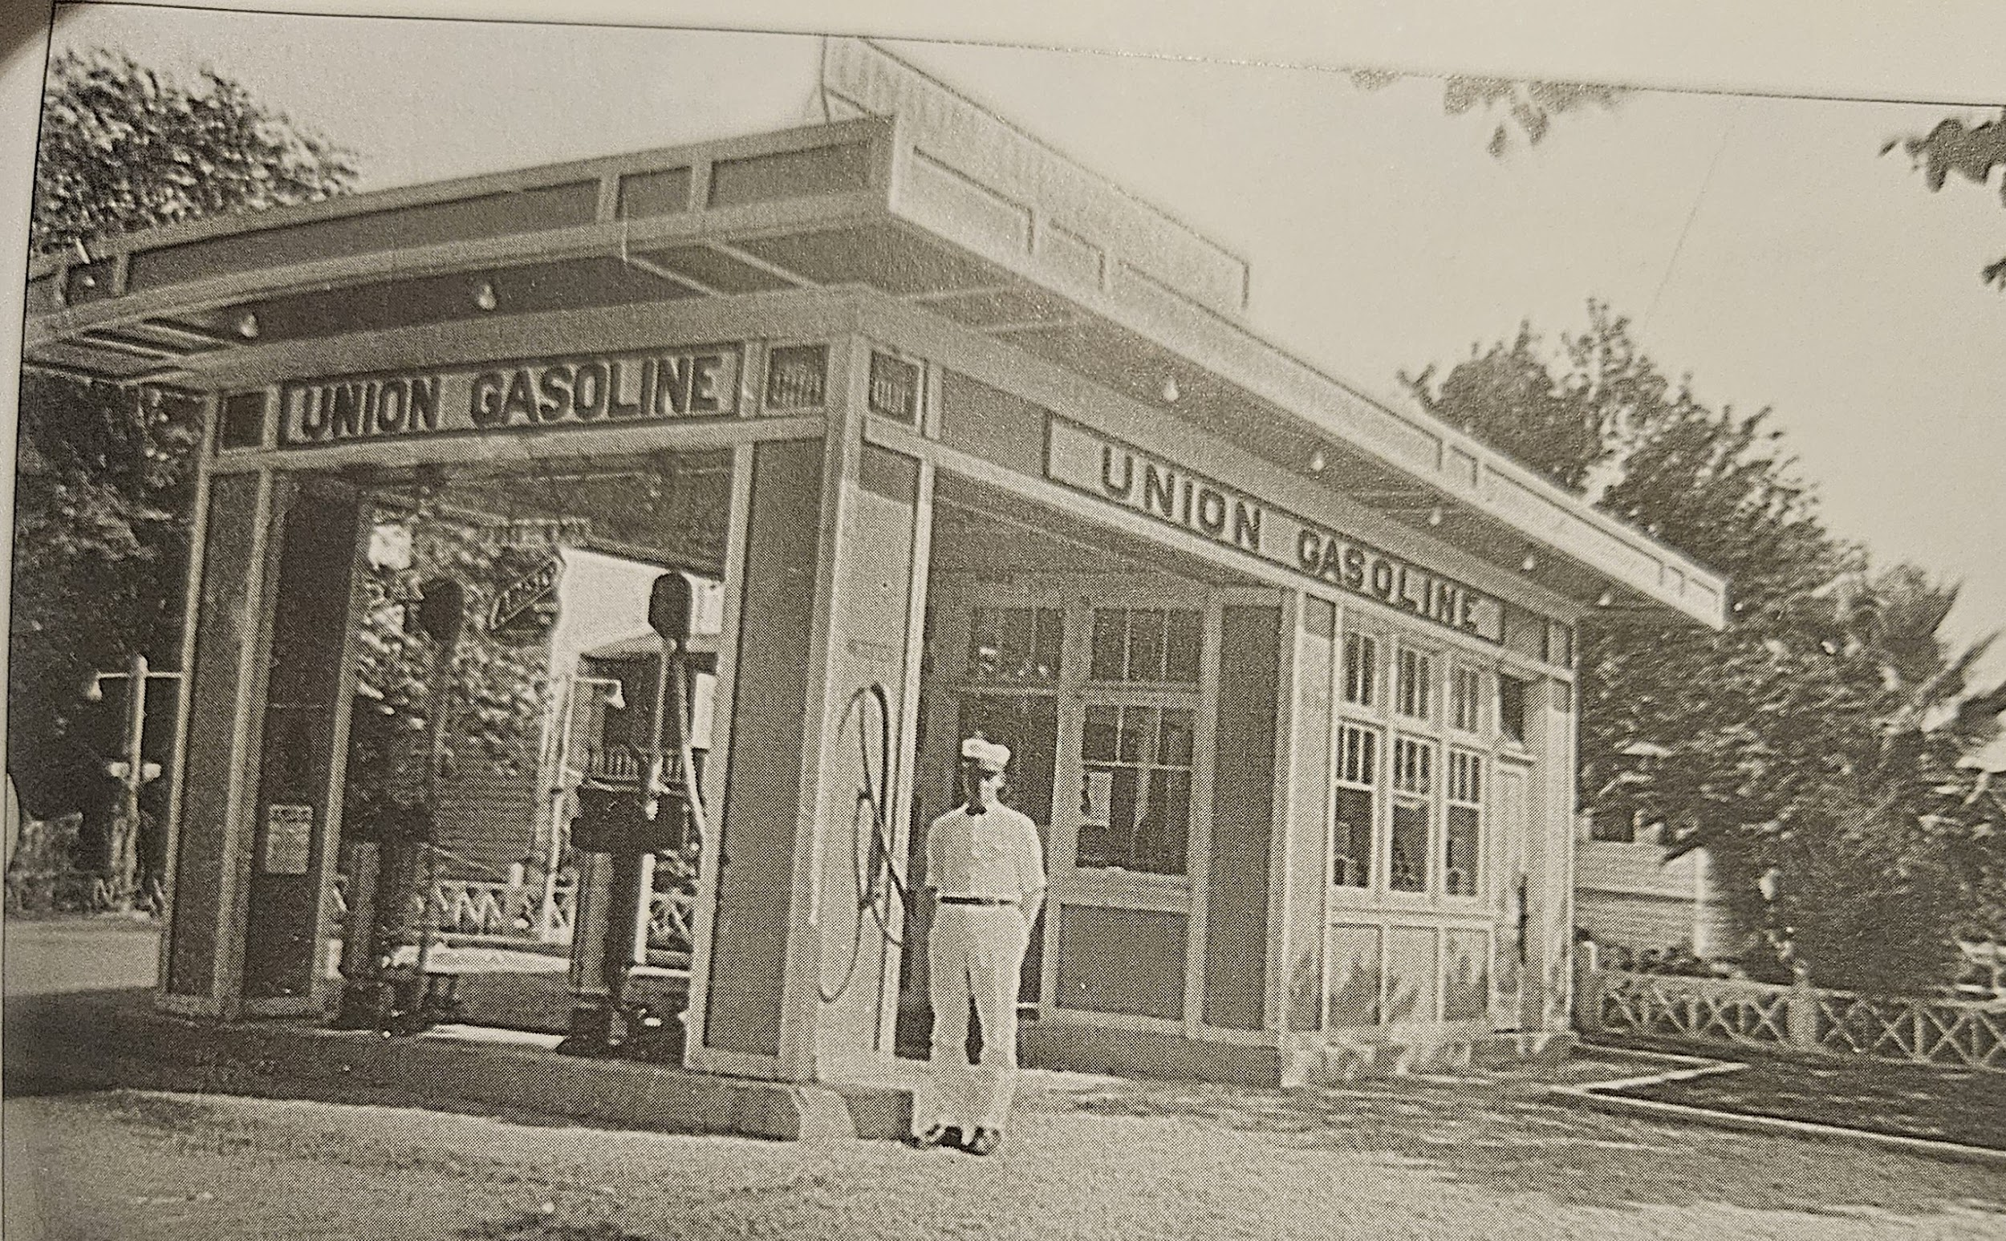
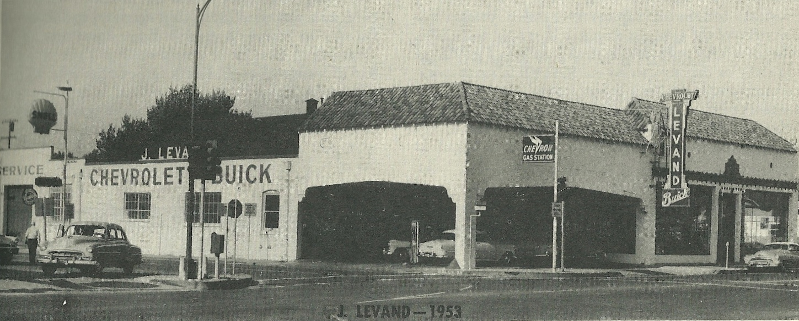
🌱 Planting the SEEDS of Success: Growing from our past; Nurturing for our future
“Grow Inside the Triangle”
Notes:
Our next branch is “Grow Inside the Triangle” which focuses on Economic Development (including Transportation, Business Support, Amenities, and more!)
Our businesses have changed throughout the decades. based on changing factors. With the introduction of the car, car dealerships, parts and maintenance, gas stations, car washes, shifting from horses and wagons and eventually from black smiths and other supportive business of the railroad and others. Business in the last ten years have shifted to include sustainability, cannabis and newer retailers. Additionally, with a shift in shopping patterns from in person to online, there is more of a need for fulfillment centers and other logistics mix.
[CLICK]

Slide 35
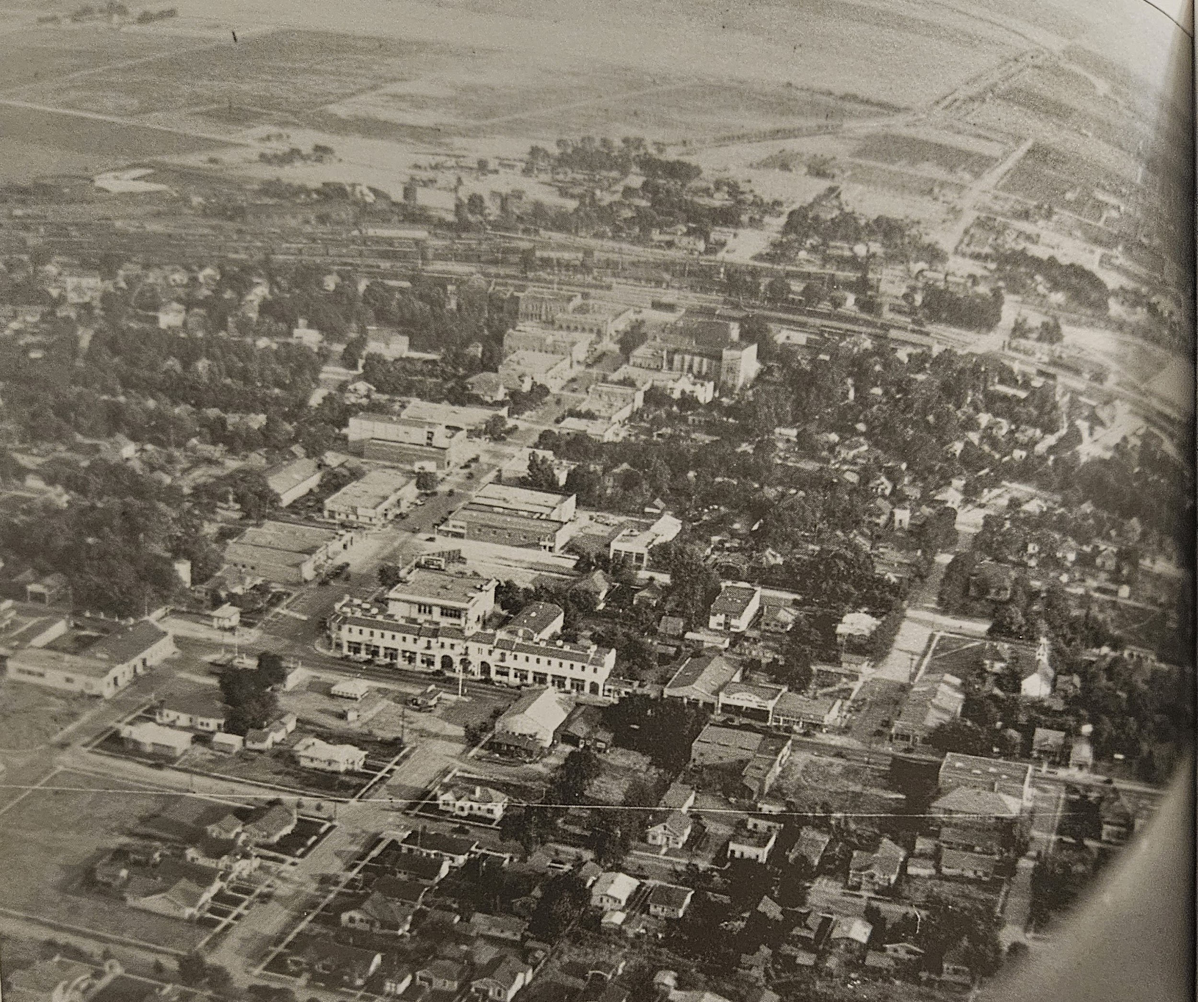
🌱 Planting the SEEDS of Success: Growing from our past; Nurturing for our future
“Grow Inside the Triangle”
Notes:
As previously mentioned, “Grow Inside the Triangle” encompasses transportation. Although it would be many decades before Tracy three Interstates forged the triangular edges of Tracy, (I205, I5, and I580). The first main street was 6th Street and that is where everything centered.
When the Lincoln Hwy, now 11th street was established, it had been the most northern part of Tracy, but soon became the main road traveled from Sacramento to the Bay Area. That gave way to new commerce.
As the city continues to grow, we’ve experienced the widening of numerous road and anticipate more, including Corral Hollow. You can look on CHCorridor.org to stay informed.
[CLICK]

Slide 36
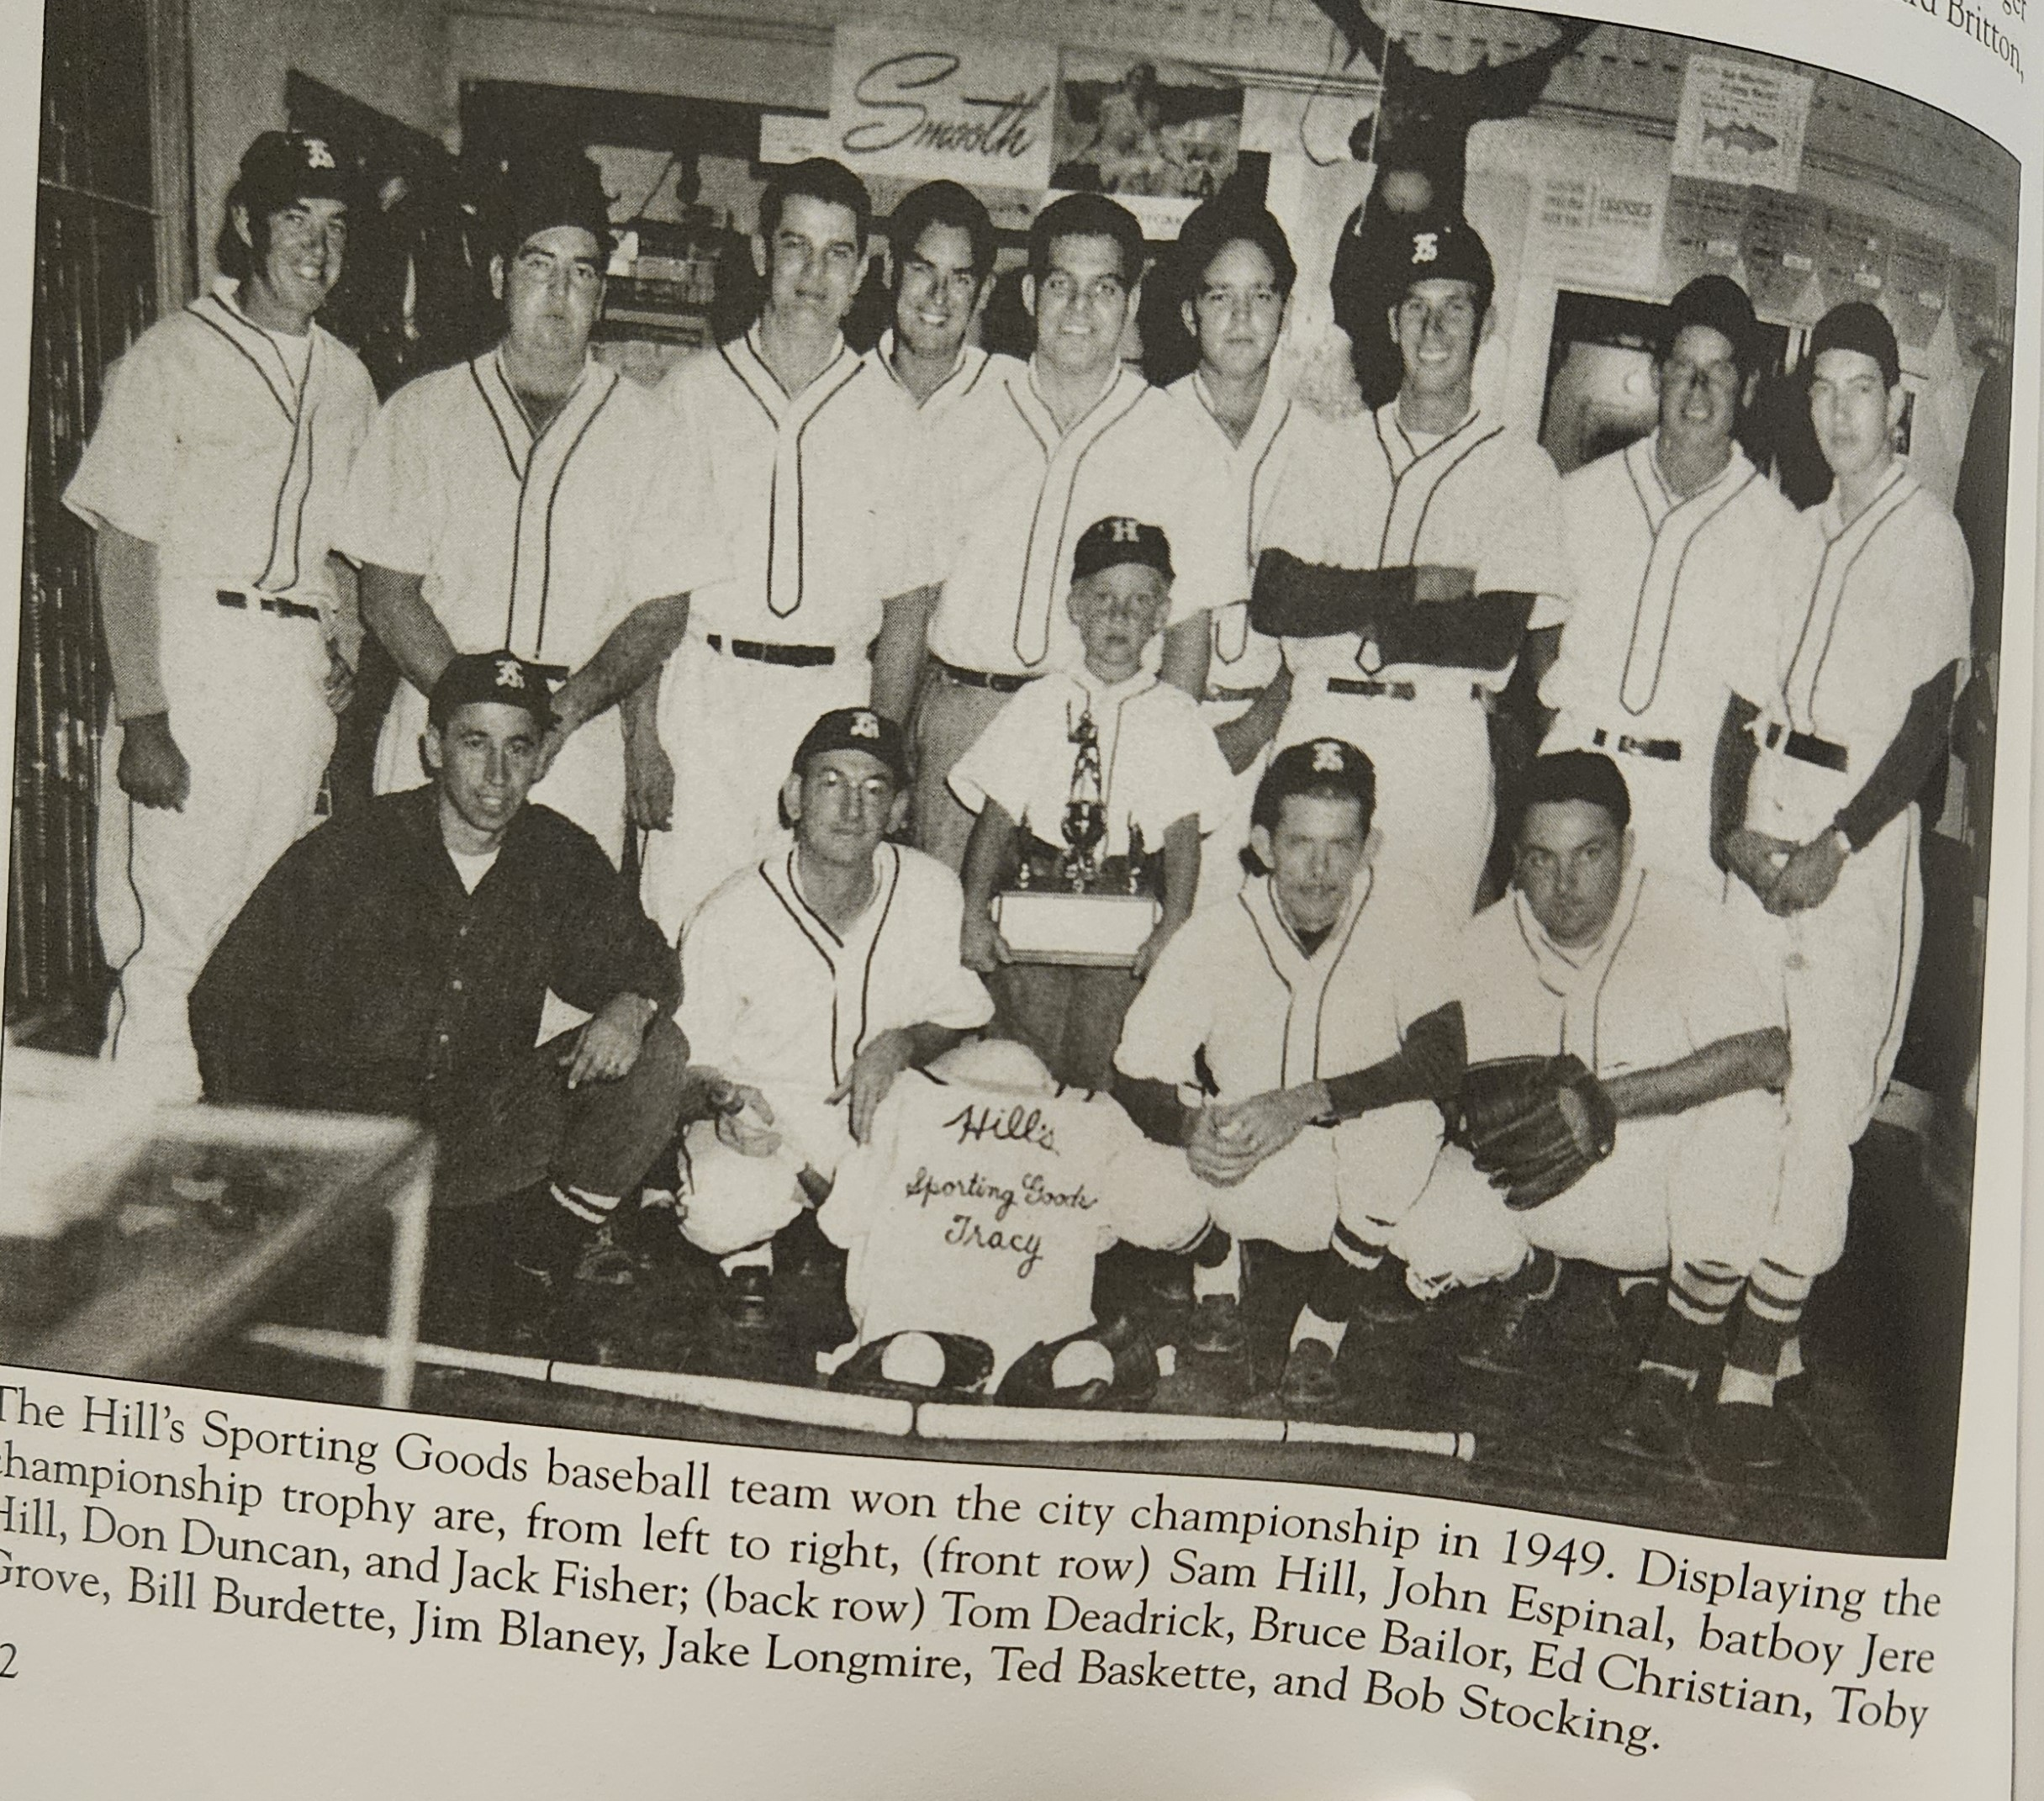
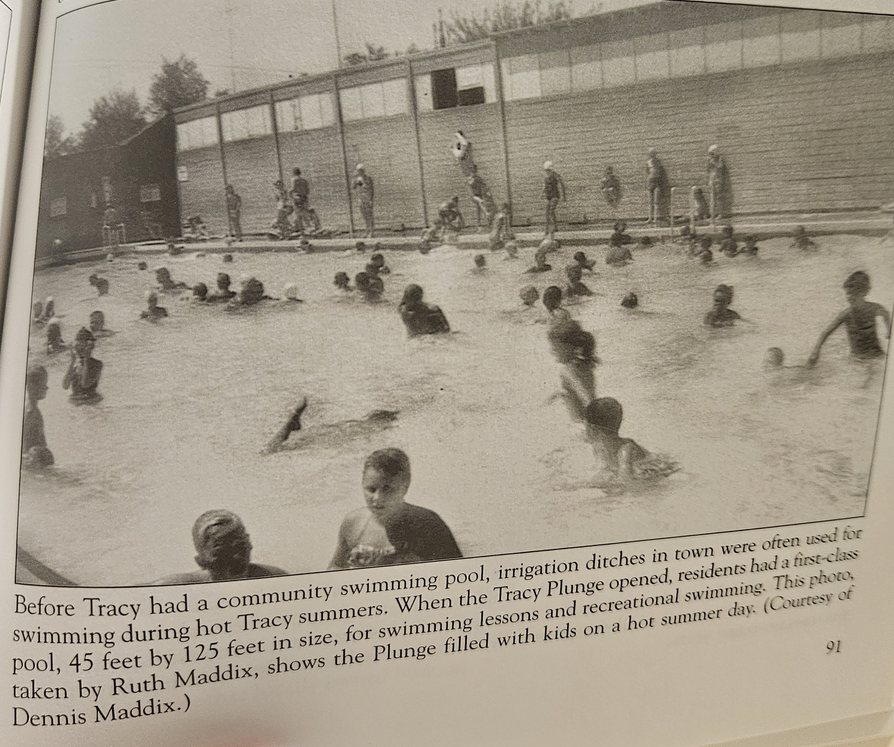
🌱 Planting the SEEDS of Success: Growing from our past; Nurturing for our future
“Grow Inside the Triangle”
Notes:
“Grow Inside the Triangle” also encompasses playing inside the triangle, which is another hashtag you may have seen on the City’s social media. When we play inside the triangle, we must think of the past infrastructure that Tracy used to do so. The pictures you see here depict [the Hills Sporting Good Baseball Team AND the Tracy Plunge]. Tracy continues to “grow” with new recreational developments, but also other amenities and resources that I will discuss with our strategic priorities.
[CLICK]

Slide 37
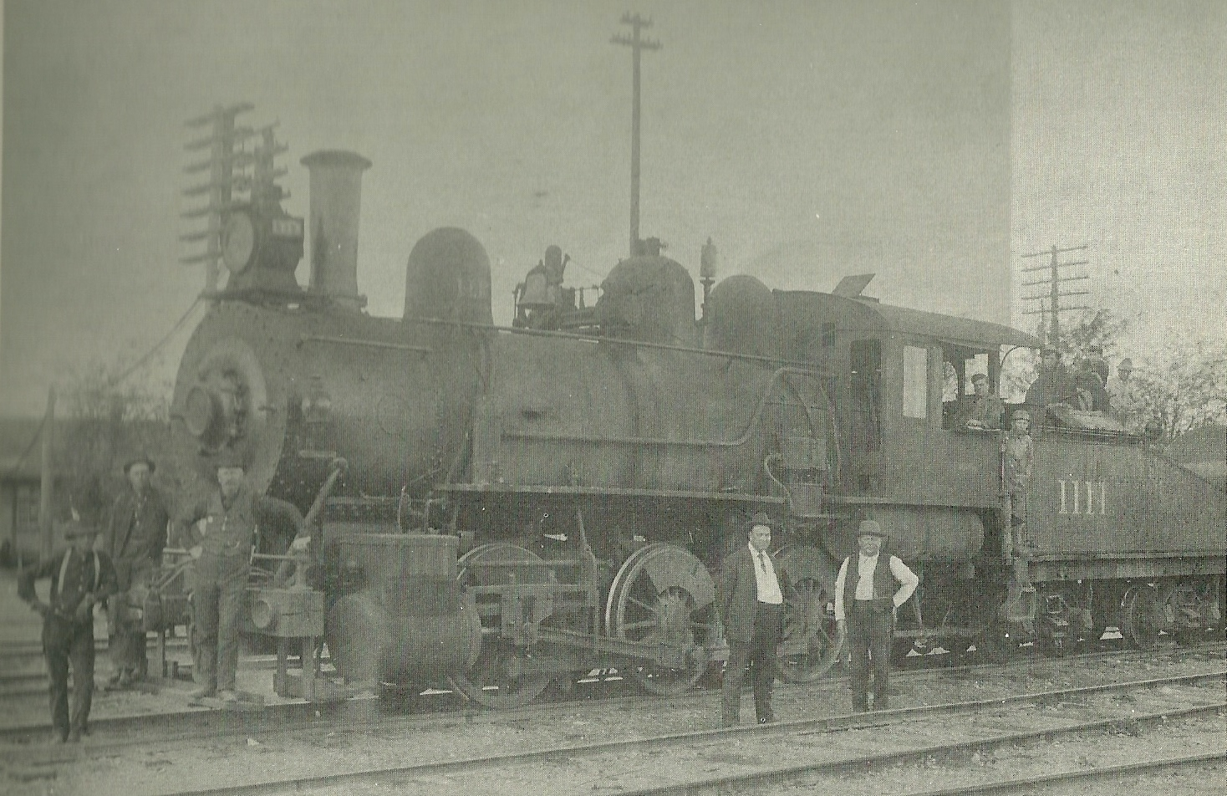
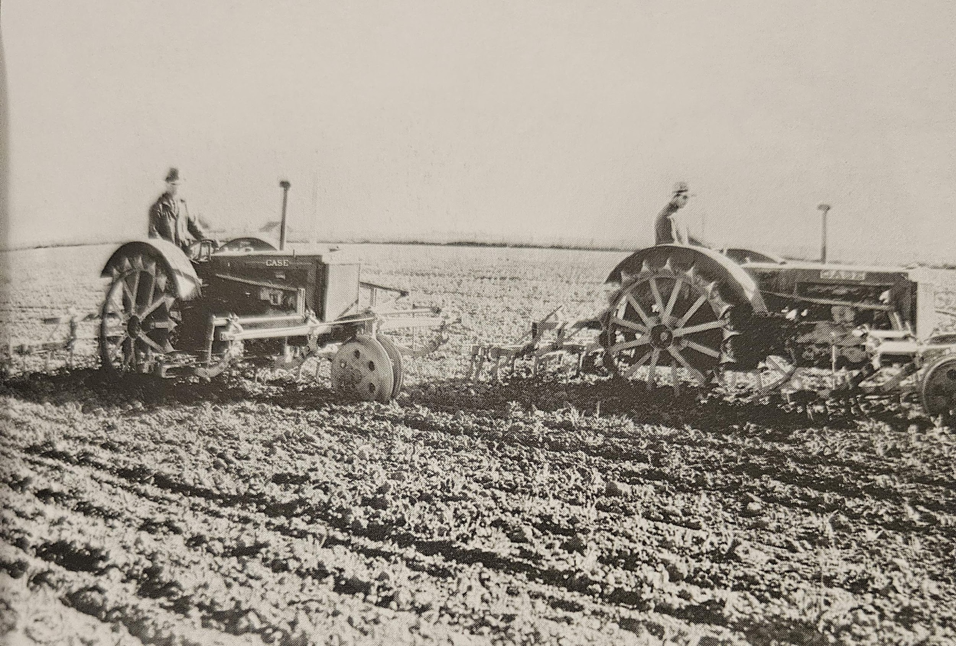
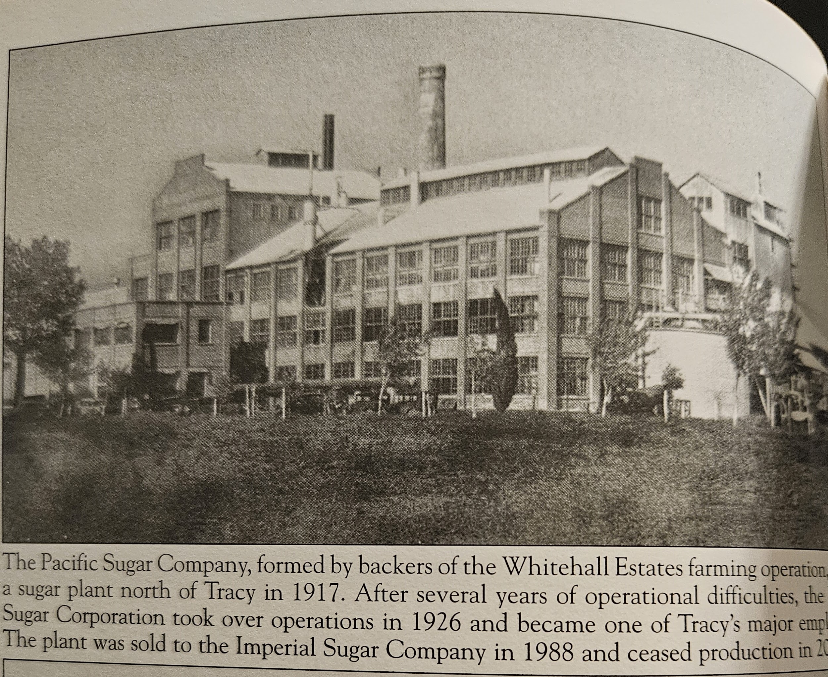
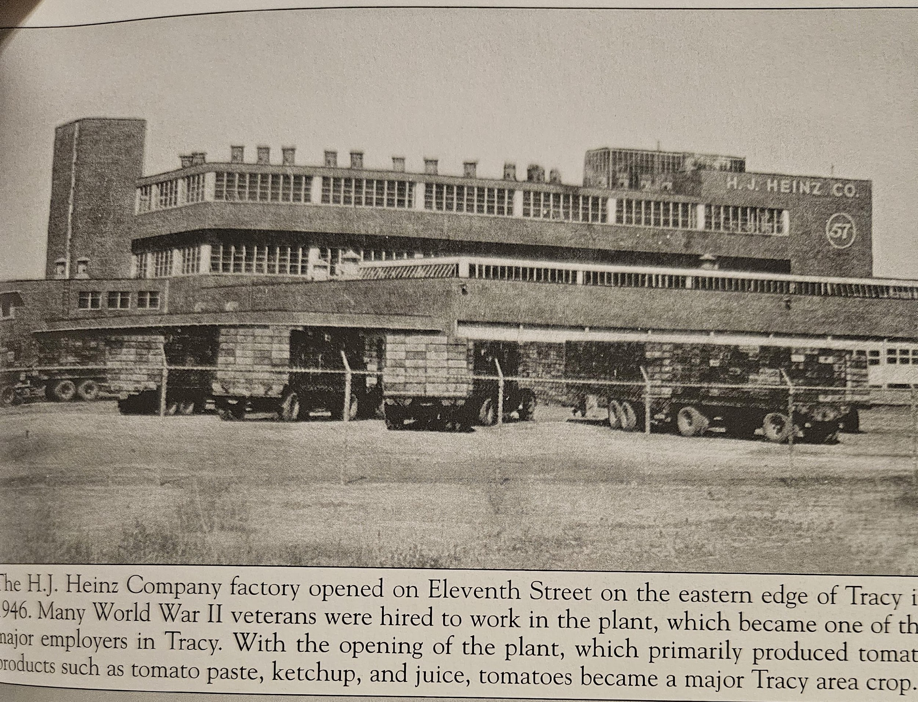
🌱 Planting the SEEDS of Success: Growing from our past; Nurturing for our future
“Work Inside the Triangle”
Notes:
Another Branch – “Work Inside the Triangle” - Economy: Business and job centers that supplied not only Tracy, but the region.
Railroad
In the late 1800s. Tracy grew with the railroads to about 500 people and became the commerce center for the area. Stores, blacksmiths, wagon makers, barbers, saloons, hotels, banks and churches were established. The railroads also made Tracy a rough and wild town.
Growing from its beginning as a town created by the railroad to a community of about 2,000 by the time it was incorporated as a city in 1910, Tracy remained a regional railroad town and local commerce center into the late 1970s.
Agriculture
By the 1950s, agriculture was Tracy’s main industry first starting with sheep grazing in the late 19th Century, then cattle ranches. With Water irrigations, crops changes to include tomatoes and sugar beets which gave birth to The Pacific Sugar Company in 1917 and Heinz in 1946.
Warehouse
Holly Sugar
Holly Sugar took over the operations of the sugar company in 1926 and became one of Tracy’s major employers even when it sold the plant to Imperial Sugar Company in 1988 until is ceased production in 2000.
Heinz became a major employer of Tracy and the region in 1946 until it closed in 1998. It increased in size over the years and served as the principal warehouse and distribution center for Heinz on the West Coast.
[CLICK]

Slide 38
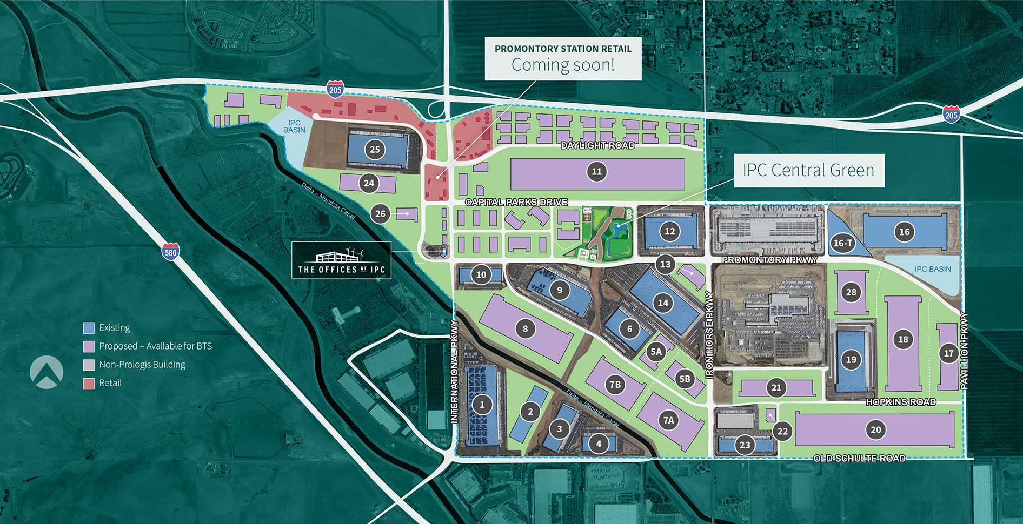
🌱 Planting the SEEDS of Success: Growing from our past; Nurturing for our future
“Work Inside the Triangle”
Notes:
Throughout the years, the job centers in Tracy continues to provide jobs not only to Tracy, but our region. We’ve grown from past employers, to current logistics, ecommerce, distribution, shipping, food processing, retail and medical supply manufacturers. Many of our present day top employers are in concentrated Job Centers planned on purpose primarily located in NEI and the IPC areas of Tracy.
Prologis began constructing the International Park of Commerce (IPC) 1800 acres in West Tracy in 2014 to complement its existing Northeast Industrial Complex (NEI) in East Tracy. Since that time, IPC and NEI have become significant employment and economic centers for Tracy and San Joaquin County.
Since 2014, Prologis and its customers created over 11,000 jobs in Tracy and over 14,000 in San Joaquin County. More than 94% of the jobs created since 2014 are permanent operations jobs. These positions offer sustainable career pathways to hundreds of residents and directly support the local economy.
· Accounted for 40% of the overall growth in employment in San Joaquin County
· Directly and indirectly contributed over $2.6 billion local earnings.
· Directly and indirectly contributed nearly $13 billion to the Tracy and San Joaquin County economy.
Our work inside the triangle is doable partly because of the resilient supply chain in Tracy. One of partners, Prologis’ International Park of Commerce (IPC) located in Tracy, CA is an essential link in the supply chain for Northern California and is critical to establishing supply chain resiliency for the region.
“When supply chains smooth, prices fall for goods, food, and equipment, putting more money in the pockets of American families, workers, farmers, and entrepreneurs.”
Prologis has invested over $200M in new infrastructure (roads, water, sewer, storm, electrical, gas and telecommunications).
Ex. provided the city with over 1,200-acre feet in annual treated water supply (enough water to fill the entire (4.5 acre) area occupied by Tracy High School Football stadium up to 261 feet).
Prologis has been a wonderful partner for the City, awarding grants, completing projects, creating jobs, initiatives and so much more.
Ex. been instrumental in financing the city’s recycled water system, installing thousands of feet of recycled pipe. - Successfully prepared and funded the $18 million grant that installed the pump and main system from the city’s wastewater treatment plan to Lammers Road and Schulte Road.
[CLICK]

Slide 39
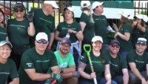
🌱 Planting the SEEDS of Success: Growing from our past; Nurturing for our future
“Work Inside the Triangle”
Notes:
Link to video used: https://www.linkedin.com/posts/claire-wilson-269867158_check-out-this-recap-video-of-our-impact-activity-7065438862516383744-ASCY?t=%7Bseek_to_second_number%7D
As all good community partners, The Prologis team actively supports community initiatives by participating in local events and charitable sponsorships supporting numerous organizations.
I’d like to share a clip of Prologis’ Impact Day at McHenry House, showcasing the impact it has on Tracy.
PLAY VIDEO

Slide 40
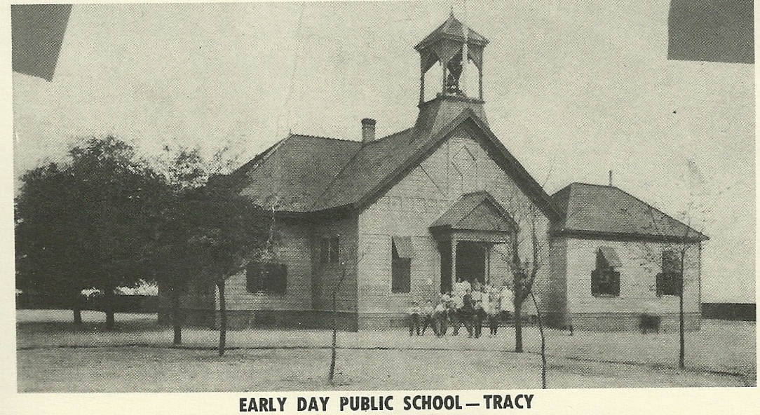
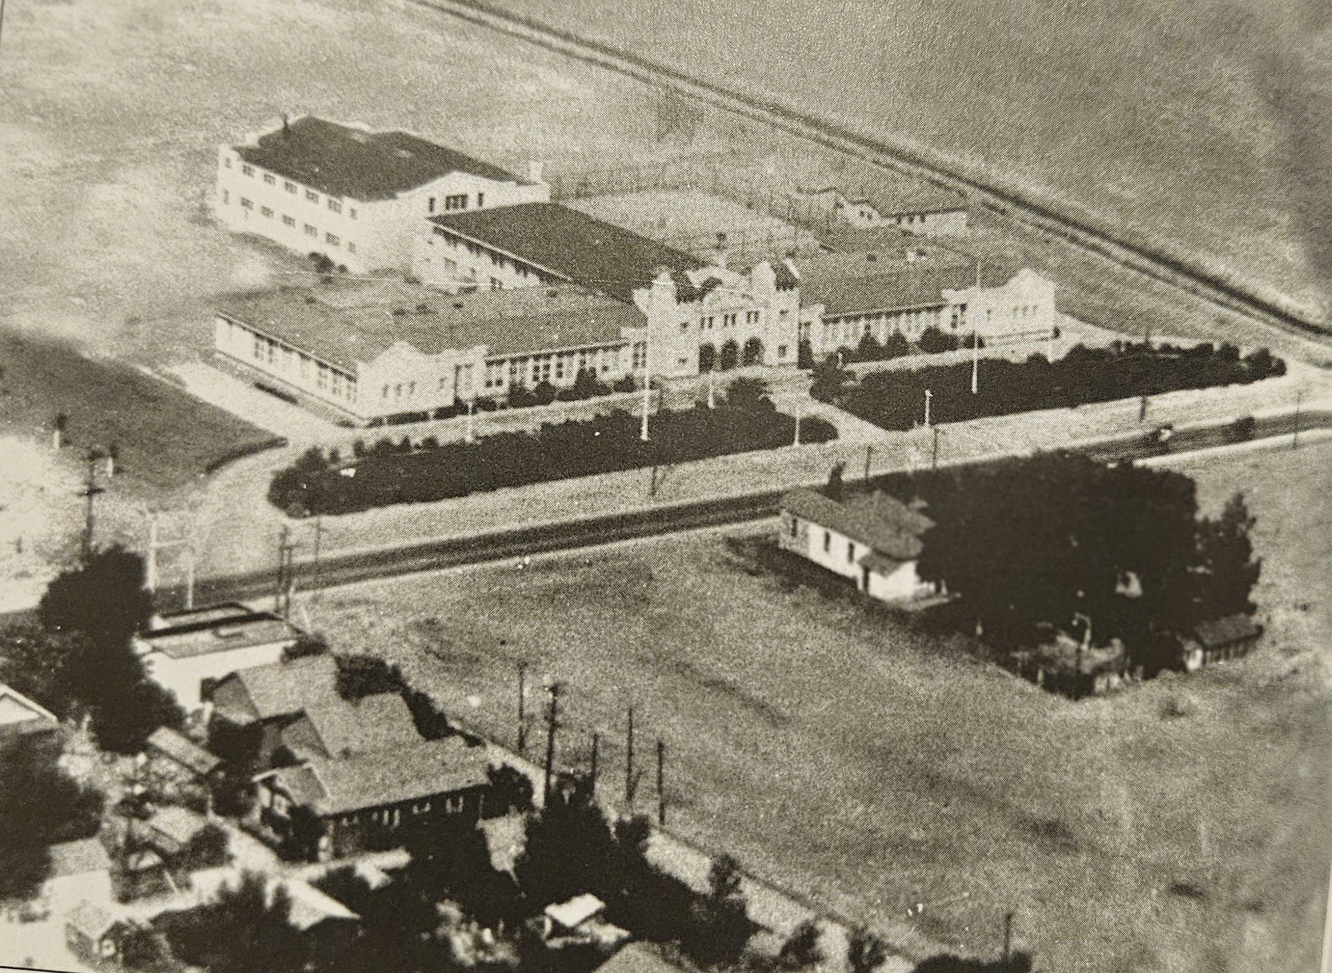

🌱 Planting the SEEDS of Success: Growing from our past; Nurturing for our future
“Learn Inside the Triangle”
Notes:
“Learn Inside the Triangle” Education –
Education was very important to the Tracy residents and schools were created in town.
from the early days of Willow School and the Senior High School later named Tracy High to the new schools that have grown to serve our growing community.
WILLOW HISTORY
1868: Willow School, a one-room schoolhouse, opens in the town of Ellis.
1878: Willow School was placed on a sled-like structure and pulled by mules to the newly formed town of Tracy. The school was placed on the corner of 11th Street and Central Avenue.
1st High School – The West Side Union High School opened in 1912 and moved to the current location on Eleventh Street in 1917, renamed Tracy Union High School in 1928
[CLICK]

Slide 41


🌱 Planting the SEEDS of Success: Growing from our past; Nurturing for our future
“Learn Inside the Triangle”
Notes:
– Education
As the town of Tracy grew, so did the need for schools.
New High Schools were opened
Merrill F. West High School opened in 1993
John C. Kimball High School opened 2009
TUSD has 19 schools K-12
Jefferson has 4 K-8
Others: Charter Schools, Lammers, Banta, New Jerusalem
[CLICK]

Slide 42

🌱 Planting the SEEDS of Success: Growing from our past; Nurturing for our future
“Learn Inside the Triangle”
New: Corral Hollow Elementary School
Notes:
– Education
Last year, Tracy Hills celebrated the groundbreaking of Corral Hollow Elementary School, a new K-8 school - the first school built in Tracy since 2008.
Soon another K-8 School will break ground in Ellis.
[CLICK]

Slide 43
STATE OF THE CITY 2024
Planting the SEEDS of Success
Strategy • Economic Growth • Entrepreneurship • Development • Sustainability
Presented by
Notes:
As we continue to move into the future, we must know that
The seeds we continue to plant year after year will determine Tracy’s future success.

Slide 44
🌱 Planting the SEEDS of Success
Strategy
Economic Growth
Entrepreneurship
Development
Sustainability
Notes:
Some of the SEEDS that have been planted and are growing are:
Strategy
Economic growth
Entrepreneurship
Development, and
Sustainability.
These principles serve as the foundation upon which our city is built, guiding us as we strive to create a vibrant, prosperous, and sustainable community for generations to come.
Remember, in order to continue to grow strong, reaping positive harvests, we must continue planting SEEDS of Success year after year…

Slide 45

City Council Strategic Priorities: 2023-2025
Governance
Quality of Life
Public Safety
Economic Development
Notes:
Today, our city stands tall, its branches reaching towards the sky, each one representing a pillar of our success because of these SEEDS.
The First S representing: Strategy
Last year, we adopted updated short-term and long-term goals in the following priority areas: Governance, Quality of Life, Public Safety, and Economic Development

Slide 46

Strategic Priority: Governance
Notes:
The purpose of our Governance priority area is to enhance fiscal stability, retain and attract new talent, improve the use of technology, and enhance transparency for the betterment of our community. I am proud of our team who worked diligently to successfully secure almost 59 million dollars in grant funding last year. Over the last five years, we have been thoughtful and strategic about digital community outreach and engagement, more than doubling our social media (or 132%). We rebranded our Innovation and Technology Division, which is now being led by our Chief Innovation Officer –Norbert Ruijling.
[CLICK]

Slide 47

Strategic Priority: Quality of Life
Notes:
We strive to provide an outstanding quality of life by enhancing our City’s amenities, business mix and services, and cultivating connections to promote positive change and progress here in Tracy. Between our Parks and Recreation Department, The Grand Theatre Center for the Arts, and our partners at the Tracy City Center Association and The Chamber of Commerce, we have something for everyone when it comes to providing programming, education, and events that bolster our quality of life.
[CLICK]

Slide 48





Measure V Funding Priorities
Completion of Legacy Fields
Aquatic Center
Multi-Generational Recreation Center
Ritter Family Ball Park Design
Nature Park Phase I Design
Notes:
As a part of the Quality of Life…
We championed Measure V in 2016 to ensure the provision of the amenities this community deserves through a half-cent local sales tax measure that sunsets in 2037. The City Council has adopted resolutions that prioritized the funding of several amenities, to expedite completion of these highly desired amenities that will have a regional draw, bringing more revenue into our City.
[CLICK]

Slide 49



Legacy Fields Phase 1
NOW COMPLETE!
Notes:
We recently celebrated the completion of Legacy Fields Phase 1E. Legacy Fields is 72 acres of dynamic recreational space,includes 10 ballfields and eight full-sized soccer fields.
We are poised to welcome over 350,000 visitors annually and invite you to be part of the legacy!
[CLICK]

Slide 50

Multi-Generational Recreation Center
Notes:
Construction is expected to begin this summer for our Multi-Generational Recreation Center at El Pescadero Park and open 2026. This is just one part of the planned upgrades, which also include a new skate park, a full-size basketball court, dog park, and splash pad.
[CLICK]

Slide 51


Strategic Priority: Public Safety
Notes:
We are enhancing community safety by promoting a responsive public safety system that includes civic engagement and partnerships, community involvement, public education, and prevention, intervention, and suppression services that meet the needs of Tracy residents.
[CLICK]

Slide 52


Strategic Priority: Public Safety
SCAN TO BOOKMARK
Notes:
Our Police Department continues to build community relationships and leverage technology to meet our public safety and transparency goals, and their 2023 annual report is available on their website for review.
Remember, NNO August 6, 2024
[CLICK]

Slide 53


Strategic Priority: Public Safety
Notes:
The South San Joaquin County Fire Authority is a well-trained, well-equipped and high-performing professional fire agency.
Excited to announce the council recently approved the building of the Fire Training facility that will break ground later this year and open 2025.
[CLICK]

Slide 54


Strategic Priority: Economic Development
Midori Lichtwardt, City Manager
City of Tracy
Maria Valenzuela, CEO
Tracy Chamber of Commerce
Forrest Ebbs, CED Director
City of Tracy
Notes:
Our economic development goals are designed to enhance the competitiveness of the City, while further developing a strong and diverse economic base. We are building our dream team to reach these goals by appointing Midori Lichtwardt as our permanent City Manager at the end of 2023. She is not wasting any time taking steps to serve our business community more effectively by bringing Planning, Building and Safety, and Economic Development under one “umbrella” as our “Community and Economic Development Department” – a one-stop shop for our local businesses. She has already appointed Mr. Forrest Ebbs as our Community and Economic Development Director. I thank Maria and The Chamber for hosting the recent Meet and Greet event.
[CLICK]

Slide 55

Strategy • Economic Growth • Entrepreneurship • Development • Sustainability
Organizational Capacity
Diverse & Resilient Economy
Real Estate Development
Quality of Life & Place
Notes:
On September 19, 2023, the Tracy City Council adopted by Resolution the City of Tracy's Economic Development Strategic Plan. This Plan provides a strategic framework and roadmap to enhance economic development and community resiliency. Key strategies include:
Organizational Capacity
Diverse & Resilient Economy
Real Estate Development
Quality of Life & Place
In the upcoming year, the City will continue to focus on attracting target industries, such as advanced manufacturing, technology, health care, and education, and utilizing Tracy’s Economic Development Strategic Plan as a roadmap to enhance the local economy. There will also be a substantial emphasis on attracting retail amenities and getting resources back into the hands of small businesses.

Slide 56

Strategy • Economic Growth • Entrepreneurship • Development • Sustainability
Population: 98,091
Households: 29,283
Average Household Size: 3.34
Housing Units: 30,249
Owner Occupied: 63%
Renter Occupied: 34%
Vacancy Rate: 3%
Median Household Income: $107,000
Median Home Value: $596,569
Median Age: 34 years old
Diversity Index: 88%
Wealth Index: 125
Educational Attainment
Associates Degree: 10.6%
Bachelor’s Degree: 18.1%
Graduate/Professional Degree: 6.3%
Labor Force: 47,688
White Collar: 58%
Blue Collar: 28%
Services: 14%
Data Source: Esri
Notes:
The next of the SEEDS planted is E for Economic Growth.
Tracy's economy has been on a winning streak, steadily growing in recent years, all thanks to its strategic location.
Tracy’s population is on the verge of hitting the 100,000 mark, a significant achievement that has paved the way for a thriving job market. This success story is primarily attributed to the expansion of existing businesses and the successful attraction of new ventures.
Tracy is the 2nd largest city in the County.
In comparison, the population of Stockton is 324,900; Manteca is 88,772; and Lathrop is 33,000.
Our median household income is $107,000, with a median home value of $596,569.
We are a relatively young community, with a median age of 34. We are also a diverse community, with a Diversity Index of 88%, which means the probability that two people from the same area will be from different race/ethnic groups is 88%—we celebrate this diversity.
The wealth index is designed not to evaluate worth but to capture the standard of living and financial stability of area households. 100 is the national baseline, so we are above average.
In our city, 35% of the population attains an associate’s degree or higher, which leads to obtaining good jobs.

Slide 57










Strategy • Economic Growth • Entrepreneurship • Development • Sustainability
New Businesses
Steal Dealz
Notes:
New Businesses to Town!
We are very excited to welcome these new businesses to Tracy:
Para Siempre Boutique recently opened and is operating in the Tracy Downtown District.
Drippin Chicken is now open and operating at 3099 N. Tracy Blvd within the shopping center of La Plaza Market.
Moonlight Nail Spa is open at 3117 N. Tracy Blvd within the shopping center of La Plaza Market
Steal Dealz recently opened at the long-time vacant property at 104 W. 11th Street, offering various discounted products, from appliances to toys and household goods.
Embarc Tracy, a cannabis dispensary, is located off Pavilion Pkwy.
Tracy Fireplace & Hot Tub Co. is operating at Northgate Village.
Heirloom Carbon Company held its grand opening in November of last year. Heirloom is a carbon removal facility that contributes to our sustainability initiative.
Burlington Coat Factory is now open and operating at the West Valley Mall site (formerly Barnes & Noble).
RE/Max expanded to a second location in Tracy’s Downtown.
Bay Area Retina Associates recently opened its ninth location, a testament to the expanding businesses in Tracy.

Slide 58

Strategy • Economic Growth • Entrepreneurship • Development • Sustainability
Sales Tax Generation
Data Source: HdL Companies 2023
Notes:
Our Economic Development Team is growing to keep up with the economic growth we are experiencing in our community. It is essential for the prosperity of our city and its residents. Over the past year, Tracy has experienced remarkable economic growth, with new businesses moving in and existing ones expanding. Our strategic location, coupled with a skilled workforce and robust infrastructure, has made Tracy a magnet for investment and opportunity, with the businesses shown as the top sales tax generators helping to contribute to the amenities and services provided to the community.

Slide 59
Strategy • Economic Growth • Entrepreneurship • Development • Sustainability
Top Employers
Business Name | Employees
Amazon.com Services LLC | 4,332
FedEx Ground Package Systems, Inc. | 1,607
Amazon.com Services LLC | 1,297
Amazon.com Services LLC | 1,043
Taylor Farms Pacific | 748
Home Depot | 700
Medline Industries | 668
Walmart | 410
Leprino Foods | 341
DHL Supply Chain | 226
Data Source: City of Tracy, Annual Comprehensive Financial Report FY23
Notes:
We asked for more head-of-household jobs and even attracted technology companies to our community. Over the past decade, 10,000 jobs have been added to our community, and we continue to grow!
Our community's future, and our ability to build a stronger foundation, rests on our commitment to invest in our youth. By equipping them with the necessary tools for upskilling and workforce development, we're not just shaping a brighter tomorrow, but also ensuring a sustainable and prosperous future for Tracy.
The table lists the top 10 employers in Tracy.
Distribution and shipping, including Amazon facilities (24/7 distribution centers requiring a significant number of employees), are the primary industries, followed by food processing and retail and medical supply manufacturers.
Not shown are the City of Tracy and Tracy Unified School District (TUSD), which are among the top employers, with Tracy Unified having over 1,700 employees.

Slide 60

Strategy • Economic Growth • Entrepreneurship • Development • Sustainability
Revolving Loan Fund
Equipment and Working Capital
Retail, Office, and Industrial
Hospitality
Entertainment
Recreational Uses
Advanced Technologies
Revitalization Enhancement Assistance
Matching Grant
Interior and Exterior Improvements
Business Incentive Pilot Programs
Notes:
The next of the SEEDS planted is the second E for Entrepreneurship.
The City Council recently approved funding for pilot programs to encourage business attraction and support existing businesses. One program will focus on key target industries such as hospitality, entertainment, recreational uses and advanced technologies. Another will be a matching grant façade program. And a third will be a loan program geared towards equipment and working capital.

Slide 61

Strategy • Economic Growth • Entrepreneurship • Development • Sustainability
Mayor’s Summer Youth Internship Program
Notes:
Through initiatives like the Mayor’s Community Youth Support Network and Internship Programs, along with support for local entrepreneurs, we are empowering the next generation of innovators and job creators.

Slide 62

Strategy • Economic Growth • Entrepreneurship • Development • Sustainability
10,792,235
Total Square Feet
9,957 Total Units
Notes:
The next of the SEEDS planted is D for Development.
Development is about more than just physical infrastructure—it's about building a community where everyone can thrive. That's why we've made it a priority to streamline the process for businesses looking to invest in Tracy. With the evolution of our Development Services Department into our one-stop shop Community and Economic Development Department, we are making it easier than ever for businesses to navigate the regulatory landscape and get their projects off the ground. So far in 2024, the Community and Economic Development Department has received 26 new applications and approved 36 applications. These applications are a variety of different projects of scale including everything from sign permits to annexation and greenfield development. There are a total of 125 pending applications under review including over 6 million square feet of industrial and commercial users as well as 4,077 residential units.
****What about the low income units the council approved with the Housing Authority a couple of months ago…please add info ****

Slide 63


Strategy • Economic Growth • Entrepreneurship • Development • Sustainability
12,000 sq. ft. commercial building
Approved on April 9, 2024
Located at 28 & 32 W. 8th St.
1st floor 3,800 sq. ft. of retail
2nd floor and 3rd floors 3,900 sq. ft. consisting of office space
14,600 sq. ft. mixed-use building
Approved on April 10, 2023
Located at 1000 N. Central Ave.
1st floor, 4,433 sq. ft. of commercial
2nd and 3rd floors each consisting of 3 residential units
Notes:
As the city grows, so does the interest in the development of the downtown area. The most recently approved project consists of a commercial building on Eight Street, just west of Central Avenue and the Grand Theater, shown on the left. This project will provide 3,800 square feet of retail on the first floor and a total of 7,800 square feet of office space on the second and third floors. The project on the right is a mixed-use project located at 1000 North Central Avenue. This project includes approximately 4,400 square feet of ground floor retail and six residential units on the second and third floors. Both of these sites are currently vacant, and the proposed improvements will have a substantial impact on the visual aesthetics of the downtown.

Slide 64

Strategy • Economic Growth • Entrepreneurship • Development • Sustainability
BJ’s Restaurant was approved in November of 2023
The project will provide 150 local jobs
Grand opening soon!
Notes:
Along with the many commercial projects under review and recently approved is the BJs restaurant located just west of the West Valley Mall. The highly anticipated project with provide 150 local jobs throughout construction and operation. The restaurant is well underway, and we look forward to its grand opening.
****What about the new Starbucks and Popeyes to open at 11th/MacArthur and the hotels on Tracy Blvd and MacArthur? Any other key businesses soon to open?***

Slide 65

Strategy • Economic Growth • Entrepreneurship • Development • Sustainability
Notes:
At the core of Tracy's operations lies a unique commitment to sustainability. Our initiatives, from renewable energy projects to fostering local entrepreneurship, are designed to build a greener, more resilient community. A prime example is Heirloom Carbon Technologies, which has chosen Tracy as its home. This partnership showcases our innovative approach to sustainable development, with projects that not only reduce our carbon footprint but also enhance our quality of life.
Tracy Renewable Energy: Our commitment to sustainability is not just a short-term goal, but a long-term vision. Projects like Tracy Renewable Energy demonstrate this. By harnessing the power of renewable resources, we are not only reducing our carbon footprint but also laying the foundation for a more sustainable future for generations to come.
Amazon’s Electric Vehicle Fleet: Tracy is proud to be home to companies like Amazon supporting electric vehicle adoption. By electrifying our transportation networks, we reduce emissions and pave the way towards a cleaner, greener future.
Chamber Green Team: Collaboration is the key to success, and our Chamber Green Team exemplifies the power of partnership. We are driving collective action toward a more sustainable and resilient Tracy by bringing together businesses, community organizations, and government agencies.

Slide 66

🌱 Planting the SEEDS of Success: Growing from our past; Nurturing for our future
Notes:
As we heard from Jennings Imel earlier, advocacy for our businesses and community is key to growing our community. It’s that watering of seeds that are needed for sustainability and growth. That’s why I’ve made it a priority to make sure we have strong relationships with all our political leaders, echoing the voices of our both our residential and business communities so that Tracy gets the funding we deserve.
Here’s a message from our US Congressman Josh Harder.

Slide 67


🌱 Planting the SEEDS of Success: Growing from our past; Nurturing for our future
Leading By Example - Planting Seeds
Notes:
Planting Seeds is all of our responsibility. It’s not just something I tell others to do, but I am leading by example.
Years ago I decided to blaze my own paths and not wait for the paths to present itself.
I chose to be the change I want to see.
I insisted on answering the call and “Being GOOD TROUBLE!!!”
"Great men(or women) don't seek to lead, but are called to it, and they answer." Movie Dune
Last year I told you, "I did it because nobody told me I couldn't... because somebody told me I should!"
If you ask anyone who has worked with me, they’ll tell you I lead by example instead of delegating everything to others.
–
Many of the things I started in Tracy were before I held a title. It is an honor to serve as the 41st Mayor in Tracy since the city's incorporation in 1910, and I look forward to passing on the city's history and expanding opportunities to those who will follow.
I am most proud of the seed I planted in 2016 that will leave behind a legacy of amenities for the City of Tracy through the passage of Measure V, a ½ cent sales tax, which is estimated to bring in over $330M over the 20 years. Even with the concerns and opposition regarding placement of the measure during a re-election year; I am grateful for the support of my former council members who voted yes to let the citizens decide to invest in themselves to build amenities. I'm forever grateful for the swim team who walked door to door to help duplicate the materials my husband and I created, with the community overwhelmingly voting yes. Then, my next council immediately voting to put in policy the funds to go towards specific amenities, beginning with the Aquatics, The Multigenerational Gymnasium, The first phase of Legacy Fields, with a fourth for the Nature Park.
–
As your Mayor, I'm proud to have:
•Made Homelessness and Affordable Housing Council Strategic Priorities
Added 3 commissions/committees, Finance, Homelessness, Environmental Sustainability with 2 youth seats, while on council
Pushed for a Senior Commission which although was voted down in 2013, brought a senior focus with Senior Link at Lolly Hansen and still continues today.
In first year as mayor, have balanced the budget for the first time in over a decade, paid down millions in unfunded liabilities, restored our higher levels of reserves, while not only unfreezing all positions, but adding new ones to make our city run most optimally, with even a waiting list for Police hires.
Opened first Fire House in 20 years
Broke ground on a K-8 school, Corral Hollow Elementary, the first school in 14 years or since 2008.
Revamped MCYSN Program
Introduced a Mayor’s Youth Internship Program
Created Tracy Connects to connect our community on several levels, fostering lasting connections for our residents and businesses alike
Guided our Council to unanimously approve $500,000 to fund the Tracy Small Business Relief Grant Program, which provided $5,000 to small businesses;
Approved funding that helped our utility services customers who needed assistance and cleared all past-due balances between March 2020 and June 1, 2021;
Brought in new opportunities and trainings availability through the African American Mayors Association (as being the first African American Mayor for Tracy);
Earned the Bloomberg Harvard scholarship to bring direct resources and training for our city staff and city.
–
Through Mayor's Benefit and Ball, plus Tracy Connects - I helped plant financial seeds to further non-profit work in our community, including:
Raising $58K for Homelessness
Raising $21,500 to Restore Learning Loss
Raising $18,500 for Behavioral and Mental Health
–
I also restored the Mayor Keys to the City - creating seeds of Acknowledgement. Acknowledging the following individuals and groups:
Veronica Vargas
Evelyn Tolbert
Zany Entertainment
Sarah McNamara
TAAA at Mayor's Ball
Filipino American National Historical Society (FANHS) Chapter and Museum at Mayor's Ball
Jass Sangha Jan 2024
Faye Harris (February 2024 Black History Month @ Central School)
Dotty Nygard - Tracy Earth Day, Bike Life, Tracy Tree Foundation, awareness for Environmental Sustainability, over 3 decades with Sutter (April 27th)
May- Steve Abercrombie for years as DARE officer, A Brighter Christmas, and TUSD School Board (May)
–
As City/County representative - I’m committed to doing my part and being part of boards of service:
CURRENT
San Joaquin Council of Governments (SJCOG)
Capitol Valley Regional Service Authority for Freeways and Expressways (CVR-SAFE) - Board of Directors - 2013-current
San Joaquin Regional Rail Commission (ACE) - Chair
San Joaquin Joint Powers Authority (SJJPA), Director
National Association of Regional Councils (NARC) Board of Directors
San Joaquin Partnership, Executive Board
San Joaquin County Sheriff CAL-ID System/Remote Area Network Committee
League of California Cities Board of Directors, Director at Large
San Joaquin County City Selection Committee Chair
Altamont Regional Traffic Authority (ARTA) JPA
San Joaquin Council of Government’s One Voice – Washington Annual Delegation for 10 years
Megaregion Board Member (Representing SJCOG)
Tracy Unified School District - Stem Community Collaborative
PAST
City and TUSD Liaison
DVI Community Board
City and Chamber Liaison
TUSD Bond - Chair
I am proud to be a founding member of:
Red Carpet/Anti-Bullying for TUSD
TUSD DEI Committee
Tracy Senior Association
–
As a community leader in organizations, I’ve been a member of and held positions in:
Tracy Chamber, Tracy Connects, Chair
Kiwanis - Past president (First Female), Board Member, founding key club advisor for Mountain House High since 2010
Student Discovery Program (mentoring 10th graders) at Kimball High 2010-2020
Boys and Girls Clubs of Tracy Board Member - 10 years)
Tracy African American Association - Past Treasurer (4 years), Juneteenth Chair (2 years), Assistant Education Chair
Volunteer- Skills Path USA - Academic Decathlon Coach - for ABL/ West High 2011-2014
Tracy Golden Agers- advocate for seniors
Founder, ED Living on Purpose Mentoring Program
Founding member of Anti-bullying committee and Equity Committee
Member of the TUSD STEM Community Collaborative
While in office, I continued to further my education and earned the following degrees and certifications:
Doctorate in Theology, 2016
American Leadership Foundation, Greater Valley, Class 8, 2016
Delta Protection Leadership Program, 2024
I have also won numerous awards, including the most recent Susan B. Anthony Award, Ella Hutchins, Kiwanian of the Year, Key Club Advisor of the Year, and Sow a Seed Adult Mentor of the Year, for my extensive work in the community, serving humanity.

Slide 68

🌱 Planting the SEEDS of Success: Growing from our past; Nurturing for our future
What is Your SEED?
Your Contribution?
Notes:
So now I ask you, What is your seed? What is your contribution?
I encourage you to be authentically you and make your own contribution to your community.- I'll tell you what I tell our youth, what I learned in 6th grade... song, "I'm somebody special" - It’s great to have mentors, but do you, Be uniquely you.
You can get some additional ideas at the 4th Annual Tracy Connects on Sept 21st
- Also, don't let your seeds be wasted, don't let your branches dry up. Stay connected, expect and demand good customer service, expect business friendly relationship with our city. Speak up when progress is blocked. Look for ways water and nurture the future of Tracy.

Slide 69

Spoken Word by Poet Laureate Tama Brisbane
Notes:
I would like to introduce the City of Stockton’s Poet Laureate Tama Brisbane to bring to the stage an original piece in the Spoken Word.
[3 minutes]

Slide 70


Special Thank You! To My Roots
Notes:
Thank you ladies..
Before I get too deep in my presentation, I want to say thank you to all my family, friends, prayer warriors, mentors, and community that has made this 12-year journey worth the trip. There has been many sacrifices along the way, but my family, truly my extended family have been my strong support. First of all, God has kept my sanity. Thanks to my ride or die: the First Gentleman of Tracy, James Young, my children: my eldest Benjamin , his wife Dianne, and son (my grandson Little Benjamin), my son Michael, my daughter Lydia and her husband Andrew, my youngest son, Nathaniel, and my extended inherited children, god children, and grands. Of course I must mention my mom, Veronica and all my siblings. (Thank you to those who are here today. Please stand. –These are my support system.

Slide 71
Presentation by Young Family
Notes:
[A video will be sent via [Drop Box to place in this spot] 5 minutes
This is a tribute from my family who have sacrificed to share my life with all of Tracy and the region these past 12 years. This is their message they want to share.

Slide 72


Slide 73

🌱 Planting the SEEDS of Success: Growing from our past; Nurturing for our future
Notes:
I want to also add a note on a chalkboard near my office that reminds us “You can’t go back and change the beginning, so start where you are and change the ending.”
There’s hope ahead if every seed planted forward is planting on and with purpose.

Slide 74


THANK YOU!
Notes:
???
As we reflect on our achievements in 2023 through today, it is clear that we have made significant progress towards our goals. From the adoption of the City's Ten-Year Economic Development Strategic Plan to critical infrastructure projects like the I-580 Corral Hollow Road Interchange, we have laid the groundwork for a prosperous future.
Looking ahead, we remain committed to our strategic priorities, and will continue to build a city that is resilient, inclusive, and forward-thinking.
I want to thank each and every one of you for your continued support and dedication to our community. Together, we have accomplished so much, and I am confident that through our collective and collaborative efforts, we will overcome every challenge that comes our way. As we continue to plant the SEEDS of success, let us remember to support the watering for each other's seeds and don’t be afraid to speak up. If we do that, the future of Tracy is bright, and the best is yet to come.
I wish you all much success.

